Slide 1

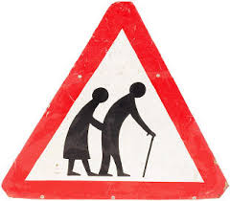
Older persons rehabilitation
Presented by Ben Wassell

Slide 2
Exercise parameters
Strength
  At least 2 days week
Cardiovascular
5 days per week (moderate intensity) or 3 days per week (vigorous intensity)
ü 150 min of mod-intensity aerobic activity per week or as physically active as chronic conditions allow
General
For most health outcomes, additional benefits occur as the amount of physical activity increases through higher intensity, greater frequency, and/or longer duration
(ACSM guidelines 2011), (Garber et al ,2011)
Notes:
Over the past few years ABI rehabilitation has seen a steady increase in the number of clients admitted over the age of 65. Many presented extremely fatigued and struggled to participate in our intensive rehabilitation program. We wondered if the FITT (frequency, intensity, time and type) principle which applied to our younger TBI population was also suitable for our older TBI subjects. Very quickly, after researching age matched exercise guidelines in both general and neurological population we concluded that our rehabilitation needed to remain individualised, however the frequency, intensity, time and type of input did not necessarily need to change based on a client’s age. While collating data on our over 65-year-old admissions, we noticed 75% sustained their TBI as the result of a falls. This left our team pondering how we could better establish and minimise falls risk for this population.

Slide 3

How do we better predict and reduce falls risk within our older TBI population?

Slide 4
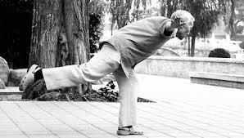
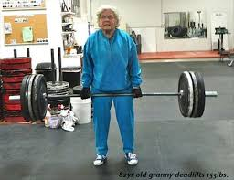
What type of exercises?
Gold- High dose balance and no walking program
Silver- High dose balance and walking program
Bronze- Low dose balance and walking program
Walking programs without a balance program may increase falls risk. Strength and balance sets the foundation before walking practice.
(Sherrington, 2008)
Notes:
Systematic R/v and meta analysis by Sherrington, 2008 showed Walking programs without a balance program may increase falls risk. So exercise programs need to predominately focus on strength and balance to set the foundation before walking.

Slide 5
Tai Chi vs Otago Exercise Programme
Tai Chi
Community based = Travel
OEP
Home based = No travel
VS
Supervision 1:15
Isolation
Social interaction***
Unsupervised
One size fits all
Individually Prescribed**
Home exercise program over 4 trials in people over 80
30-46 percent reduction in falls,
28-39 percent reduction in injury
Fewer hospital admissions,
Increased exercise function 55 % decreased in mortality risk
(Liu Ambrose etal. 2008 JAG 56, 1821-1830) (Thomas et al. 2010 Age Ageing 39, 681-687)
Notes:
After ongoing research and discussion with AUT university we determined the most effective adjunct to our rehabilitation program to reduce falls was the ‘Otago fall program’
This program could be implemented as part of a client’s daily therapy then carried over into the communityThis program could be implemented as part of a client’s daily therapy then carried over into the community.

Slide 6
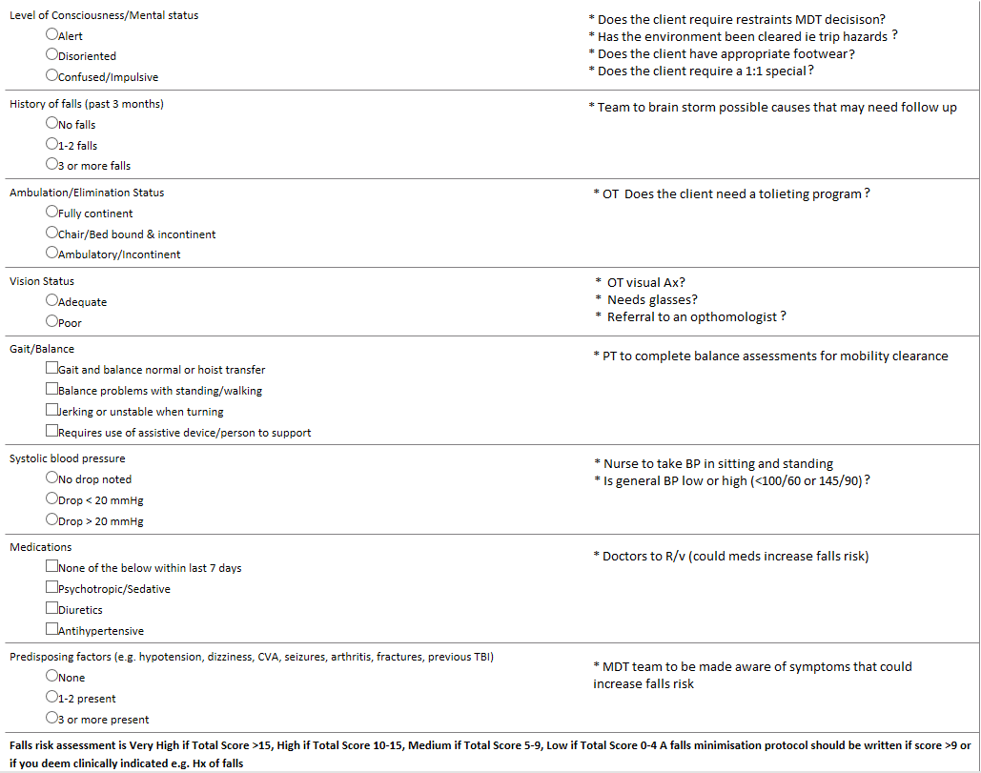
Falls Risk Assessment Tool
Notes:
Rather than just identifying risks with no clear plan of action. Now we can clearly identify and attempt to manage falls risks.

Slide 7

Questions
What outcomes should we use to better predict falls from a gait/mobility perspective?
Objective, subjective or Both?
Do objective falls risk predictors match subjective measures?
Does post traumatic amnesia state have an influence on falls risk based on objective or subjective measures?
Notes:
Clear clients a s safe to mobilise independently or with assistanceLETS DO A RESEARCH TRIAL (META ANYLSIS) With OUR OWN CLIENTS AND HAVE A LOOK AT THE OUTCOMES

Slide 8
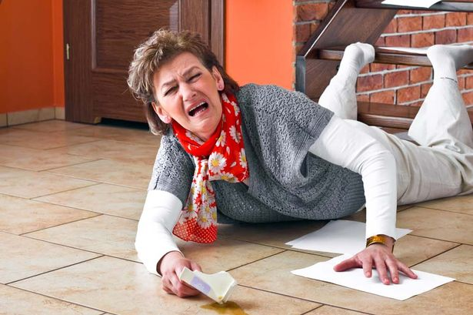
Objective measures
Berg-49/56
Step test- <7 (D/c from outpatients)
Step Test- 10 (Outpatients rehab)
10MWT- >12 (comfortable)
FSST- >15 seconds/inability to complete (FES-I associated with poor FSST result)
6MWT- 250m
ST & FSST (four square step test)- implicated due to high risk of trips; obstacle navigation 15 seconds (community dwelling) 12 sec (vestibular disorders)= falls risk
70-78% prediction of falls if < cut off score
(Mackintosh et al., 2006), (Blennerhassett, 2012) (Joshi & Sadhale, 2014 )
Notes:
. Based on current literature the team also put together multiple objective assessments to predict falls risk in this population from admission until discharge. We wondered if a subjective self-assessed fall risk scale, one which had been validated in neurological populations could also help predict falls risk in our TBI population. Based on this data we would be able to establish if actual falls risk (based on our objective assessments) matched with a client perceived falls risk. These results were also compared to PTA state to see if this had any correlation to perceived falls risk.
Based on current literature the team also put together multiple objective assessments to predict falls risk in this population from admission until discharge. We wondered if a subjective self-assessed fall risk scale, one which had been validated in neurological populations could also help predict falls risk in our TBI population. Based on this data we would be able to establish if actual falls risk (based on our objective assessments) matched with a client perceived falls risk. These results were also compared to PTA state to see if this had any correlation to perceived falls risk.

Slide 9
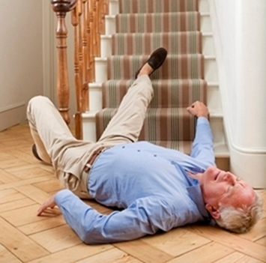
Subjective measure
FES-I
Fear of falling questionnaire
Validated in Neurological populations and older populations
(Delbaere et al, 2010)
Notes:
Fear of falling inversely increased over time in elderly community dwelling populations.
Falls are a predictor of increased fear of falling
Often used in Community dwelling
West mead for PTA

Slide 10
Data recorded
Admissions over a 6 month period
Aged >65 years of age
12 Subjects tested
Recorded at admission and discharge
  3 objective measures
  1 subjective measure
  PTA testing (Westmead)
Notes:
For whatever reason in 6 of the subjects all the assessments were not completed in full on admission or discharge. So when I went to record the Data I could see only 2/3 outcomes were assessed or the FES1 was forgotten on discharge or on admission.

Slide 11

PTA State
11 of the 12 subjects tested had PTA scores of 10 or higher on admission
2 remained in PTA on discharge
No clear correlation between level of PTA, falls risk or fear of falling

Slide 12
75 percent of those who presented as having a low fear of falling were considered a high falls risk based on objective outcome measures
67 percent of those who presented as having a moderate fear of falling were considered a high falls risk based on objective outcome measures
89 percent of those who presented as highly fear full of falling were also considered a high falls risk based on objective outcome measures
Notes:
Only 4 clients had a low fear of falling but only one was considered an actual falls risk based on outcome measures.
75% of people who reported having a low fear of falling were actually a high falls risk.

Slide 13
Admission Discharge
No change= 5
Moderate to low= 2
High to moderate= 1
Notes:
70-78% predictor of falls <cut off

Slide 14
Results
No clients had any falls during the study.
No clear correlation between low and moderate fear of falling (FES1) and objective measures (Berg, Step Test, 10MWT) in TBI clients over 65.
PTA state does not seem to have an effect on fear of falling or falls risk.

Slide 15
Discussion
3 objective measures seem to be an effective falls predictor for our over 65 TBI population.
Subjective measures weak predictor of falls in this population group?
Is a subjective measure (FESI) a good adjunct to our falls assessment measures though?
PTA state (depth of PTA)
Risk taking behaviour is not necessary based on PTA in this population.

Slide 16
References
ACSM guidelines (2011) “Medicine & Science in Sports & Exercise” The official journal of ACSM
Blennerhassett JM, Dite W, Ramage ER, Richmond ME. (2012) “Changes in balance and walking from stroke rehabilitation to the community: a follow-up observational study” Arch physical rehab. 93(10):1782-7.
Delbaere, K, Close JC, Heim J, Sachdev PS, Brodaty H, Slavin MJ, Kochan NA, Lord SR. (2010) “The Falls Efficacy Scale International (FES-I). A comprehensive longitudinal validation study” Age Aging 39(2):210-6.
Garber, Carol E, Blissmer B, Deschenes M, Franklin B, Lamonte M, Lee I, Nieman D, Swain D. (2011) “Quantity and Quality of Exercise for Developing and Maintaining Cardiorespiratory, Musculoskeletal, and Neuromotor Fitness in Apparently Healthy Adults: Guidance for Prescribing Exercise” Medicine & Science in Sports & Exercise. 43: 1334-1359.
Joshi S, Sadhale A. (2014) “Predicting Falls in Elderly : A Comparison between Berg Balance Scale & Dynamic Gait Index” Indian Journal of Physiotherapy & Occupational Therapy. 8(3): 136-140.
Liu-Ambrose T, Donaldson MG, Ahamed Y, Graf P, Cook WL, Close J , Lord SR, Khan KM. (2008) “Otago home-based strength and balance retraining improves executive functioning in older fallers: a randomized controlled trial” Journal of American Geriatrics. 56(10):1821-30.
Mackintosh SF, Hill KD, Dodd KJ, Goldie PA, Culham EG. (2006) “Balance score and a history of falls in hospital predict recurrent falls in the 6 months following stroke rehabilitation” Arch Phys Med Rehabil. 87(12):1583-9
Sherrington C, Michaleff Z, Fairhall N, Paul S, Tiedemann A, Whitney J, Cumming R, Herbert R, Close J, Lord S. (2008) “Effective exercise for the prevention of falls: a systematic review and meta-analysis” 56(12):2234-43.
Thomas S, Mackintosh S, Halbert J. (2010) Does the “Otago exercise programme' reduce mortality and falls in older adults?: a systematic review and meta-analysis” Age Ageing. 39(6):681-7.

