Slide 1
A descriptive analysis of peer-consultation among an international specialist social work e-network: The experience of the International Network of Social Workers in Acquired Brain Injury.
Authors: Grahame Simpson (Australia), Elly Nadorp (Canada), Emma Weeks (New Zealand)

Slide 2
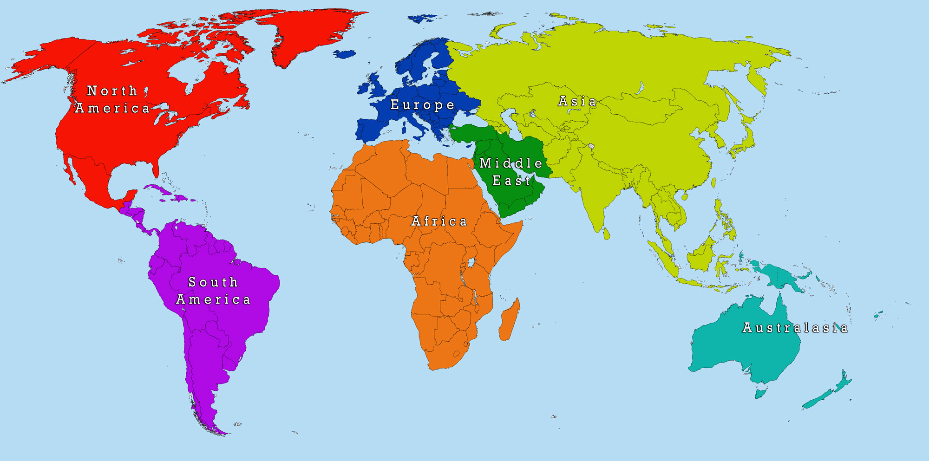
INSWABI – who are we?
SWEDEN
UK
CANADA
IRELAND
BELGIUM
USA
INDIA
AUSTRALIA
NEW ZEALAND
Notes:
The International Network of Social Workers in Acquired Brain Injury (INSWABI) is an e-network of 130 social workers from nine countries specialising in the field of ABI. The large majority of members are practitioners (over 90%) with a smaller number of academics, researchers and social work managers also joining.

Slide 3
Aims of INSWABI
Notes:
Members from Australia, New Zealand, United States, Canada, United Kingdom, Ireland, Belgium, Sweden and India have joined an e-list with the aim to provide each other with (i) information exchange, (ii) development, (iii) support, (iv) advocacy, (v) innovation, and (vi) education among social workers with an interest in brain injury.

Slide 4
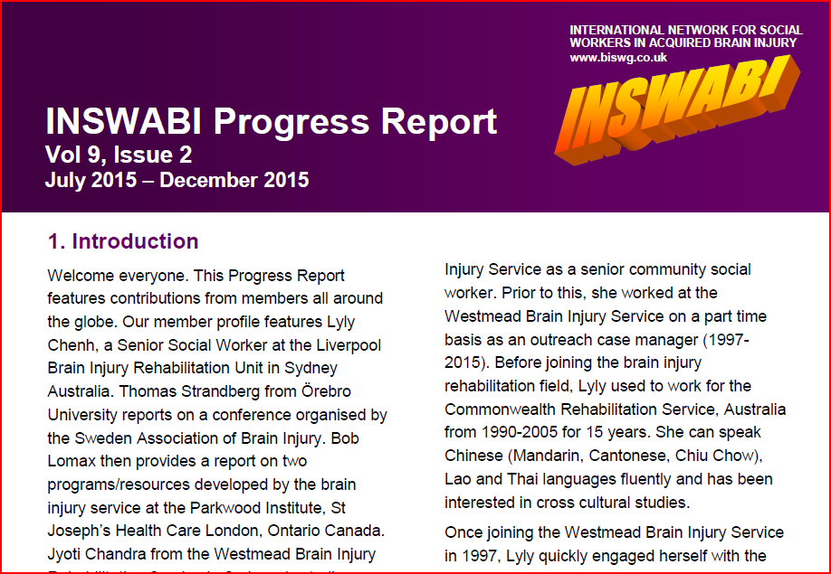
Notes:
Information is also shared amongst members via a webpage hosted by BISWG (the Brain Injury Social Work Group) based in the UK and a six monthly Progress Report emailed to all members.

Slide 5
The role of SW in ABI
Notes:
For the purposes of the INSWABI network the term ‘acquired brain injury’ relates to both traumatic brain injury which are injuries to the brain that are the result of external force arising from falls, motor vehicle accidents and assaults, and acquired brain injury which is a more general term that refers to any acquired injury to the brain tissue which is not developmental in nature such as strokes, infections, brain tumors or hypoxia which occurs following a decrease of oxygen supply to the brain.
Brain injury regardless of mechanism can result in numerous impairments ranging from mild to severe. Common impairments following a brain injury include physical aspects such as vision, mobility, poor co-ordination; cognitive aspects such as attention, information processing, memory, and executive functions such as problem solving; language difficulties which impact on the ability to understand and communicate effectively and behavioural issues such as reduced insight, impulsivity, irritability and disinhibition.
The role of social work in ABI, as with any field of social work, is vast and varied. As social workers, we work with both the person with the brain injury and often in the initial stages act as a support for family as advocates and operating as liaison points between the family and rehabilitation/medical team. We are also counsellors, discharge planners and facilitators of ongoing social supports. Every case is different as is every recovery after ABI. Social workers may find themselves working with people at different stages in their brain injury recovery starting from the time they are first admitted into the acute hospital setting, to working with people in the community many years post injury.

Slide 6
History of INSWABI
Notes:
INSWABI was established in 2005 at the 5th International Conference for Social Work in Health and Mental Health in Hong Kong. It was a joint initiative of the Social Workers in Brain Injury from New South Wales Australia and the Brain Injury Social Work Group from the United Kingdom. Both were practice interest groups formally affiliated with their national professional social work associations. INSWABI was modelled on two pre-existing networks: The Social Work and Health Inequalities Network and the American Oncology Social Workers Network, both of which comprised an international network and conducted their business largely by e-mail. INSWABI then established an executive management committee in 2010 with representatives from all countries, who now take responsibility for the ongoing management of INSWABI. There were a number of drivers for the establishment of INSWABI:
(i) The growing specialist nature of health care in Westernised countries meant that there were an increasing number of ‘niche’ specialty areas
(ii) The existing infrastructure within the profession (e.g., the national associations, academic schools of social work) often needed to take a broader view of the social work profession and therefore provided limited focus or support for social workers practising in such specialty areas
(iii) Despite this there are substantive matters that face the profession within the field around issues such as evidence-based practice and the role of the profession which are too large for individual practitioners or researchers to tackle, and
(iv) By creating international linkages, there was the potential to build a critical mass to help advance the profession within the specialty field.

Slide 7
“properly used networks can help improve .. performance in a number of ways, broadening .. exposure to new ideas and solutions and giving .. increased access to the expertise of leaders in your field”.
Dulworth (2006, p.37)
Notes:
Within the literature, Dulworth (2006, p.37) highlights that the role of “properly used networks can help improve .. performance in a number of ways, broadening .. exposure to new ideas and solutions and giving .. increased access to the expertise of leaders in your field”. With an exponential growth in our access and use of communication technology both in our personal and professional lives , online networks assist in offering opportunities to share professional knowledge and support with our peers on an international scale (Mishna et al, 2012; Macia et al, 2016).

Slide 8
Between 2012 to 2015
50 Requests for information via email
Information gathered was sorted into
TOPICS
RESPONSES
SATISFACTION
Notes:
This current project was initiated by the INSWABI Executive committee. Peer consultation has proved to be the activity around which INSWABI members most often engage. Therefore, the aim was to describe the peer-consultation conducted through the e-list over four years between 2012 and 2015 since it was first established.
In terms of the peer consultation process, any INSWABI member is able to use the e-network to initiate a question or issue and seek feedback from other INSWABI members. The peer consultation is monitored by one of the network co-convenors who stores the e-mail communications on a password protected computer.
All the stored network emails from the study period comprised the data for analysis in this presentation. Three templates were devised to sort the extracted data. The first template was used to analyse the topics initiated by members. Each unique e-mail was inserted verbatim into the template, along with data about the date of the enquiry and the country from where the question came. The second and third templates were used to place any data about (ii)responses made by INSWABI members to queries raised; and (iii) any expression of member satisfaction with the process.
Two authors (EW, EN) then independently conducted a thematic analysis, identifying the key categories within which the questions could be grouped. The two sets of categories were then compared and a final set derived through consensus.

Slide 9
Outcome measures | Working with students | Family support strategies | Priority rating scales | Social work staffing ratios
ABI and addictions | Welcome and transition packs for clients | Resources for young carers | Skills for Social Workers working in ABI | International referrals for clients repatriating to country of origin
Service delivery for clients with ABI in acute care vs inpatient vs day programme vs outpatient vs community | Screening / documentation tools | Body temperature changes after ABI | Working with children with ABI | Effectiveness of family conferences
Case management | Social Work brochure | Living Journal | Emotional and Psychological consequences of TBI | Best Practice guidelines
Notes:
A total of 50 requests for information were made during this four year period, an average of 12.5 per year, from members based in Canada, Australia, New Zealand, USA and Ireland. Analysis identified a number of emerging groupings of questions raised by INSWABI members. On initial investigations we were able to categorize the requests into the following 20 topic areas :
Use of outcome measures
Working with students
Family support strategies
Priority rating scales to manage waitlists
Social work staffing ratios
Working with ABI and addictions
Welcome and transition packs for clients
Resources for young carers
Skills for Social Workers working in ABI
International referrals for clients repatriating to country of origin
Service delivery for clients with ABI in acute care vs inpatient vs day programme vs outpatient vs community
Use of screening / documentation tools
Body temperature changes after ABI
Working with children with ABI
Effectiveness of family conferences
Use of a Social Work brochure
Use and benefits of a living Journal
Emotional and Psychological consequences of TBI
Best Practice guidelines. Maybe give a sample questions for each topic area?

Slide 10
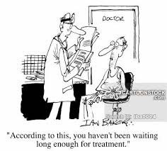
How many Social Workers do you have?
How do you prioritise lengthy waiting lists?
Notes:
Response rates to these topic areas varied but to give an example of requests received, the following two requests generated the largest number of replies amongst INSWABI members:
“We are currently reassessing the number of social work staff we may need and I was hoping to benchmark this against other units” – A total of 11 responses from different rehabilitation centres across 6 countries (Australia, Canada, Ireland, NZ, UK and USA) shared information on this topic.
“Do you (or other members of INSWABI) use a priority rating scale to manage lengthy outpatient waitlists?” – A total of 10 responses from different rehabilitation centres across 4 countries (USA, Australia, Ireland, Canada) replied.

Slide 11
Clinical
Family support strategies, how to support young carers, working with addiction
Service delivery
Case management, acute care vs rehabilitation, paediatrics, family conferences.
Tools
Screening tools, documentation tools, welcome and transition packages, social work brochures and living journals.
Research and Training
Outcome measures, priority rating scales, best practice guidelines
Notes:
Thematic analysis of the 20 topics identified four overarching areas:
Service delivery - This encompasses questions in relation to case management, acute care vs rehabilitation, paediatrics, family conferences, international referrals and benchmarks for social work staff-patient ratios.
Tools – This area included matters raised in relation to the knowledge and use amongst the network of screening tools, documentation tools, welcome and transition packages, social work brochures and living journals.
Research and Training - This incorporated queries around use of outcome measures, priority rating scales and best practice guidelines. And finally,
Clinical – Discussion was raised in relation to family support strategies, how to support young carers and working with addiction.

Slide 12
Notes:
The field of ABI has its own complexity of impairments and treatment modalities, which challenges the social workers in this field to continually expand their knowledge in order to serve clients and families to the best of their capability. Consulting with social workers in ABI internationally helps social workers in this field to not only use best practice models of treatment, but also to feel encouraged and supported.
With the advancement and value of technology in our day to day lives, peer consultation in speciality social work areas is increasingly viable and accessible on this international scale.

Slide 13
Notes:
Undoubtedly following closer analysis of the peer consultation process between 2012 and 2015 the INSWABI e-network is an effective forum for social workers specialising in ABI to share knowledge, experience and resources not only in clinical practice, use of tools and overall service delivery but also in advancing international social work practice in this niche area through collaborative research and education.
Further to this initial study we are planning to conduct a systematic satisfaction survey of members who initiated requests to determine the usefulness of responses received and analyse the effectiveness of the e-network in supporting international ABI social work practice.

Slide 14
Notes:
Thank you.
Any questions???

Slide 15
Authors
Dr Grahame Simpson (Co-Convenor)
Research Group Leader Social Worker – Clinical Specialist
Brain Injury Rehabilitation Research Group, Ingham Institute of Applied Medical Research, Liverpool Australia
Elly Nadorp (General Member)
Part time Care Coordinator/Social worker
Arnprior Regional Health, Ottawa Canada
Emma Weeks (General Member)
Director of Rehabilitation Wellington
ABI Rehabilitation, Wellington, New Zealand

