Slide 1
Strategies to engage family with in-patient rehabilitation and community re-integration
Jonathan Armstrong, Director of Rehabilitation
ACRM October 2017
Notes:
Common Theme!
As per Amit’s presentation - Access to formal services is not limitless (and very scarce in some places!) therefore maximize the use of family in community integration
NZ context. Very lucky in comparison! Very well funded in relation to TBI (even compared to USA, UK etc), however, resources are still not limitless and we work in a context that values family as a rehabilitation partner – we might be the brain injury experts but they bring the expertise of what it is like to live within their own cultural contexts and this knowledge is invaluable for successful rehabilitation and community reintegration…
What I want to introduce is an approach that is used within an in-patient rehabilitation centre that integrates families as partners in the rehab journey
But before I go any further, let me set the scene a little for you all….

Slide 2

Notes:
I know that a lot of people associate New Zealand with this….However, this is Auckland…

Slide 3

Notes:
Where ABI Rehabilitation is based.
New Zealand is not a large country – population wise we are 4.6 million – similar to the State of Louisiana. Geographically, we are 268,000 sq km – similar to the size of Oregon or Colorado
Auckland itself has a population of 1.5 million so approx one third of the country’s population. Auckland is very diverse - it is home to the largest Polynesian population of any city, 40% of its population were born overseas, 17% of Auckland’s population is Maori – the indigenous people of NZ.

Slide 4
Funding for rehabilitation services
Accident Compensation Cooperation (ACC)
Provides comprehensive, no-fault personal injury cover for all residents and visitors to New Zealand.
One national contract for funding rehabilitation services for moderate-severe brain injuries – TBIRR
Three national providers of rehabilitation services

Slide 5
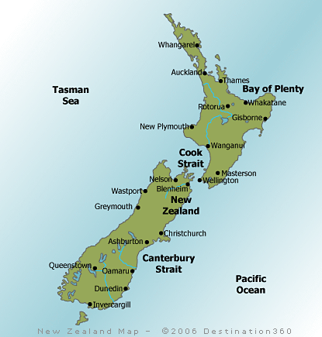
ABI Rehabilitation:
Two sites – Auckland & Wellington
Covering the North Island and the top of the South Island
Approx. 80% of the NZ population
ABI Auckland – 33 beds
ABI Wellington - 17 beds

Slide 6
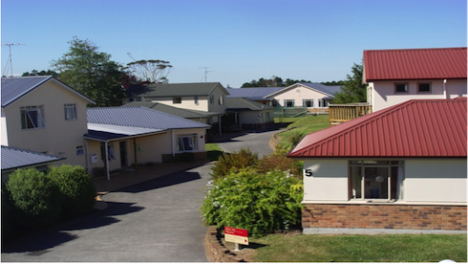
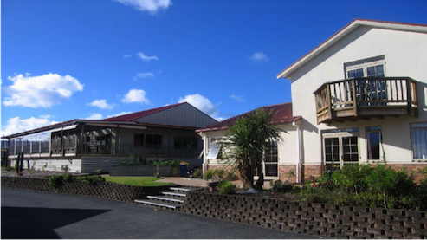
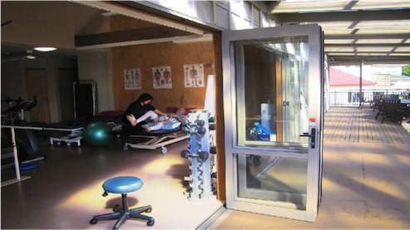
Notes:
The Rehab Team:
Medical team
Registered Nurses
Allied Health
Rehab Program Coordinators (RPCs)
Rehab Program Workers (RPWs)
Administration
Household, laundry, maintenance staff

Slide 7
Why family is a focus
Cultural Considerations
  Major cultural groups in New Zealand are Maori, Pacific Islanders and Europeans
  Maori and Pacific Island cultures “family-centric”
  Focus on building relationships with therapists rather than a more patient-practitioner model
  Maori are over-represented in the TBI population
Political Considerations
  Outcomes for Maori clients are poor compared to European Clients. Vital to engage family in process.
  Generally lower socio-economic status

Slide 8
Evidence for family engagement
“A key element for success in post-acute brain injury rehabilitation programs” (Evans et al, 2008)
“Professionals are encouraged to see themselves as teachers and help families learn about brain injury and recovery” (Kreutzer et al, 2010)
“Therapists should address family functioning and family perceptions of patient function to facilitate more favourable patient attitudes regarding program therapies and active patient compliance with therapy activities” (Sherer et al, 2007)
Notes:
There is evidence to show that clients whose families are engaged in their rehabilitation, through active participation or established working relationships with rehab professionals, go on to have better outcomes than direct clinician delivered rehab – e.g.s…***

Slide 9
Concepts from qualitative research
Family bring the “real world” (context)
Family provide the sustainability
Family reinforce and provide repetition
Provide the client with feedback
Provide feedback for the therapist

Slide 10
Therapeutic Alliance
Client
Family
Rehab Team
Early engagement, cultural needs, listening, joining, education, skills training, community reintegration

Slide 11
Early Engagement
Brain Injury Nurse Specialist in the acute hospitals
Their role is to identify and monitor patients in the acute hospital suspected of having a moderate to severe brain injury
Therapeutic relationship with family starts here
They are the first contact for families coming into our service and provide the families with relevant information
They gather history for an IDT handover prior to admission
Visits to the ABI site
Early goal setting to establish expectations
Notes:
They are a source of information and support - Providing verbal and written information
Identifying concerns and expectations prior to admission

Slide 12
Meeting cultural needs
Maori comprise a disproportionately large percentage of TBI rehab clients
Feedback from Maori revealed processes are perceived as medically structured, instead of specifically tailored to the client, whanau or culture
Standard cultural safety considerations
Recruitment of Kairahi Kopapa Maori (Maori Support Person)
Leads a dynamic process of ongoing interaction based on mutual respect, trust, openness and desire to return to good health
Karakia, Pepeha, Greetings, Waiata…
Awareness of Maori Health Models – “Te Whare Tapa Wha” (Durie, 1994)
Emerging Maori specific assessments – “Te Waka Oranga” (Elder, 2017)
Keeping families together (whanau house)
Notes:
Maori population – 17%, Maori ABI population – 28% (2016 stats)
Across New Zealand there is recognised need for process that better engage Maori clients and their whanau in rehab
Based on different world-views, Maori and non-Maori have varying interpretations or definitions of a rehab program, family, participation etc
Kairahi Kopapa Maori role – fluent in Tikanga Maori, advises on Maori issues, integrates the use of Maori custom into the rehab team process, smooth transitions between acute, rehab and community
Te Whare Tapa Wha – four aspects: Te Taha Whanau (family), Te Taha Tinana (physical health), Te taha wairua (spiritual health), Te Taha Hinengaro (mental/emotional wellbeing)
Te Waka Kuaka and Te Waka Oranga – recognizing the importance of assessing whanau cultural needs and understanding the concept of wairua, making time for cultural engagement
Carlos will be talking more on this in a broader sense and provide some more specific strategies in his presentation next

Slide 13
Actively listening
Keyworker’s (KW) role is to act as the families link to the rehab team
KW is also responsible for reporting to ACC (funder)
Goal setting with the rehab program coordinator and client/family
Core Team meeting held within first three days of admission to set rehab strategies that match with family/client goal
Initial family meetings held within the end of the first week
Family have the option of running the meeting how they choose
Ongoing family meetings (“Hui”)
Make time/space to listen to concerns, hopes, expectations…
Notes:
Initial family meeting - with the aim of strengthening relationships, providing education, reporting to ACC, opportunity for questions to whole team

Slide 14
Joining (active involvement)
Family are welcomed into therapy sessions
Positively reinforce the client’s efforts
Witness progress for themselves
Decisions are negotiated
Steps towards achieving client/family goals were negotiated initially with family and then with the client when they are able to participate in this
Families participate in timetabling and rehab activities

Slide 15
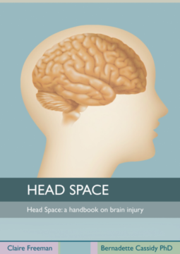
Education
On brain injury and recovery
  Written
  Verbal
  Pictures
  Individualised
Normalising
Managing concerns/fears
Notes:
Freely available resources – “Headspace”, client based resources, client rehab folders

Slide 16
Skills training
Teaching family specific skills
  Hoisting
  Feeding/PEG
  Self-care
  Behaviour management
  Using communication aids
Shift of responsibility from rehab provider to family (self-management strategies)
Prepare for discharge

Slide 17
Community Reintegration
Families are prepared for the client’s return to their home and community in a graduated way
  Outings
  Day leave
  Overnight stays
Community based rehab activities and groups
Trialing strategies in the “real world”
Discharge planning meetings to include community rehab providers
Notes:
Graduated discharge
outings with family asap
day leave as family become more confident with skills training and education, and client gains independence
Overnight stay with feedback from family about the strategies that worked and those that did not
Community rehab providers engaged early to, again, build those relationships at the earliest possible opportunity and provide seamless transition to the community

Slide 18
Current community reintegration models
The four most commonly cited frameworks:
Jacobs (1993) - expert opinion
Willer et al (1993) – rehab professionals, researchers
McColl et al (1998) – people with TBI
Wong and Soloman (2002) – based on literature review
More recent work on deriving a framework:
Parvaneh and Cocks (2012) – practitioners, researchers, policy makers, people with ABI, and their families
Notes:
Very diverse dimensions within each framework likely due to them being derived from different views
Parvaneh and Cocks – still a critique in that it does not go far enough to educate the community, the family, the wider cultural context re the person with ABI.

Slide 19
Family/Whanau engaged in rehabilitation
Early engagement
Early communication with family in the acute hospital
Identifying concerns prior to admission
Orientation to rehab facility
Family involvement in early goal setting
Listening
To the family’s concerns
Their experience so far
Their plans for the future
Their hopes for the client
Informal and formal family meetings
Joining
Welcomed in to therapy sessions
Involved in rehab activities
Participating in the rehab
Seeing the progress being made
Positively reinforcing the client’s efforts
Education/Skills training
On brain injury and recovery
Psychosocial interventions
Normalising
Managing concerns/fears
Teaching specific skills
Shifting responsibility
Community reintegration
Graduated discharge
Feedback and revision
“Real world” context
Cultural needs
Kiarahi Kopapa Maori
Dynamic processes
Keep families together
Cultural relevant assessment
Notes:
Participation time – based on these 6/7 areas: early engagement, cultural needs, actively listening, joining, education, skills training, community reintegration – where might your rehab facility/service focus and get the most gains for increasing family/whanau engagement?

