Slide 1



An Aging Population in Traumatic Brain Injury Rehabilitation: Outcomes and Resource Implications
New Zealand Rehabilitation Conference
8-10 September, 2017
Christchurch
Allison Foster, PhD
ABI Rehabilitation

Slide 2
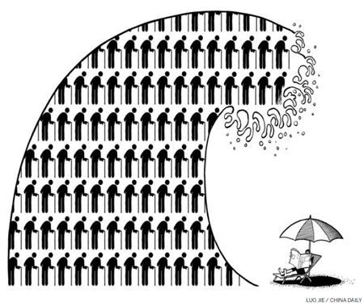

Slide 3
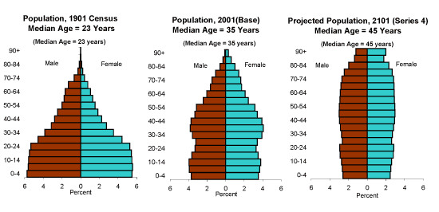
Heading
Text
Copy and paste this slide

Slide 4
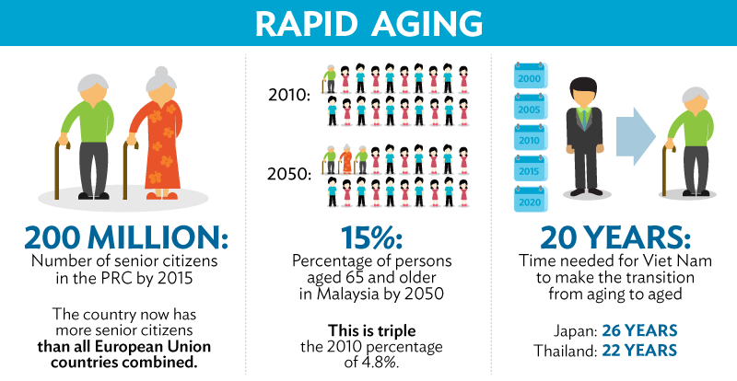
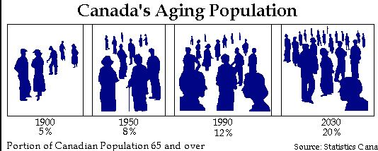
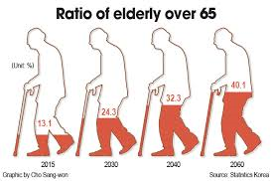
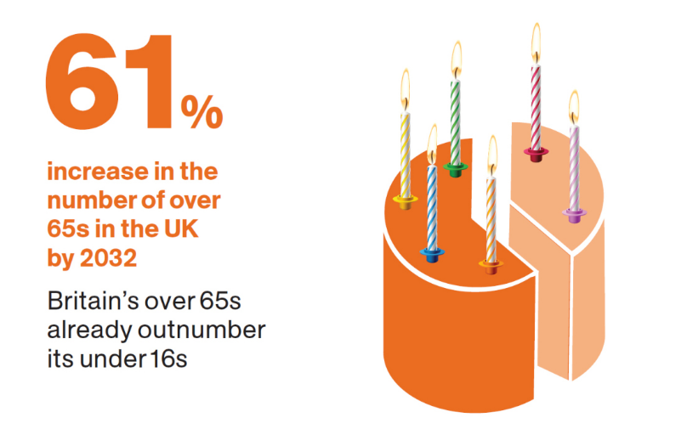

Slide 5
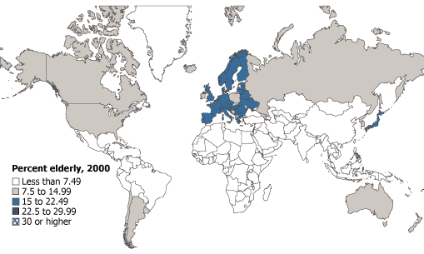
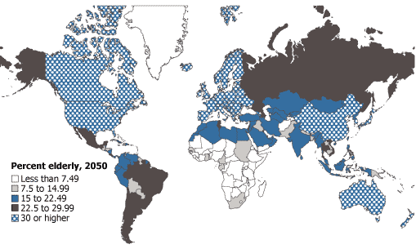

Slide 6
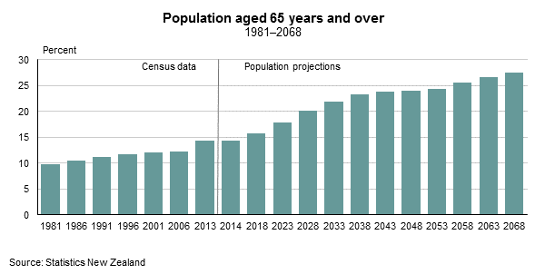

Slide 7
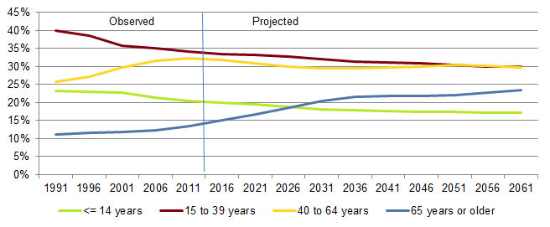

Slide 8
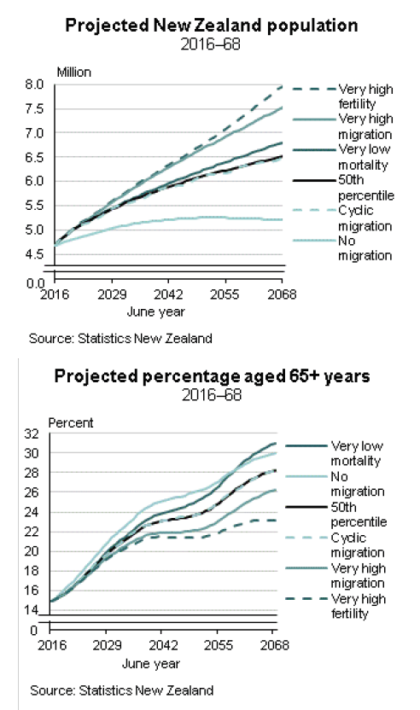
According to census figures, currently there are nearly 0.75 million New Zealanders over the age of 65.
Over the next 30 years this figure will double to more than 1.5 million.
No other age group is growing at such a rate.

Slide 9
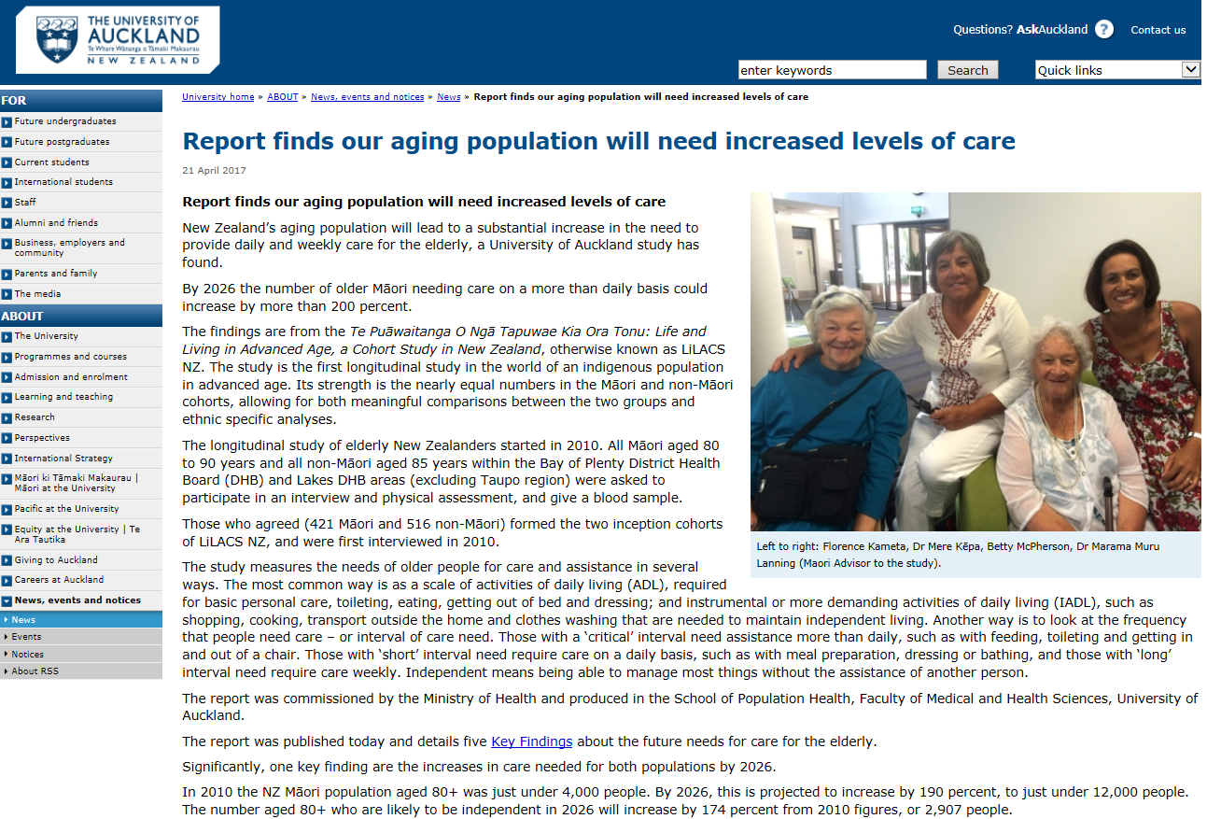
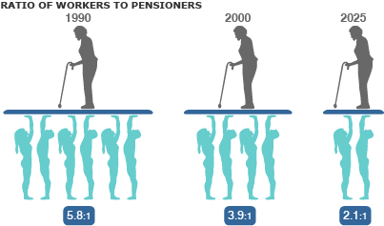

Slide 10

Implications for older persons in a traumatic brain injury (TBI) rehabilitation programme
All consecutive moderate-to-severe TBI discharges over a 3-year period (2014-2017) at an inpatient post-acute rehabilitation provider (2 sites) were anonymised and analysed.
Notes:
Approx 80% of the country

Slide 11
Proportion >65
Our TBI rehab
18.6%
Across 3-year period 2014-2017: 665 first-time admissions from the acute hospital
General population
14.9%
2016 calendar year, census

Slide 12
How do older clients differ from the younger cohort?
 | 65 and older | Under 65
Average age | 72.8 | 36.7
Age range | 65-88 | 15-64
Gender | 37% women, 64% men | 25% women, 75% men

Slide 13
What are the differences in injuries?
 | 65 and older | Under 65
GCS | 63% mild 21% moderate 16% severe | 42% mild 20% moderate 38% severe
PTA duration | 35.2 days (± 30.0) | 27.6 days (± 27.5)
Casemix | 59% in more-severe categories | 42% in more-severe categories
Hospital LOS | 26.0 days (± 24.3) | 19.1 days (± 18.3)
Notes:
GCS: Mild = 13-15. Moderate = 9-12. Severe = 3-8.
Casemix: the % of clients in more-severe AN-SNAP classes (AROC v3; 202, 213, 214, 215, 240, 241)

Slide 14
What is the difference in rehab course?
 | 65 and older | Under 65
LOS in rehab | 51.8 days (± 45.9) | 37.8 days (± 45.7)
Returns to hospital | 28.2% of clients | 19.0% of clients
FIM gain | 33.6 points (± 22.2) | 33.8 points (± 26.1)
FIM gain/day | 0.65 | 0.89
Discharge to | 78% home 8% rest home 7% hospital | 93.5% home <1% rest home 3% hospital

Slide 15
Resource drivers for older clients
7 days longer in hospital
7 days longer PTA
14 days longer rehab stay
Comparable FIM gains, but
  Less favourable efficiency and
  Lower rate of returning home
Approximately 30% longer than younger cohort

Slide 16
Projections

Slide 17
Projections for our rehab service

Slide 18
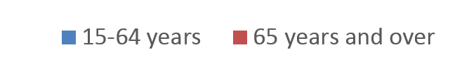
Projections need to incorporate total number, proportions, and resource utilisation
“Those in the oldest category had significantly higher numbers of re-hospitalizations, home health care visits, and hours per week of unpaid care, and significantly lower numbers of physician and mental health professional visits than younger age groups.”
JOURNAL OF NEUROTRAUMA 29:1864–1871

Slide 19
What can we do?
….Hmm, and where should we focus?
“There is a paucity of information available regarding TBI in older adults. Much of what is known is primary outcome data on mortality or GOS scores from subanalyses of larger studies. This is a significant gap in the literature; current care of older adults with TBI is guided solely by guidelines derived from previous work primarily done in younger adults.”
  J Am Geriatr Soc. 2006 October ; 54(10): 1590–1595.
“[Community integration] should be a primary rehabilitation goal after TBI; however, the limited evidence base means that health care professionals who offer services to [older] people with TBI have a very limited evidence basis on how to best meet the needs of this growing population. Furthermore, we know very little about how variations in the demographic characteristics may also influence community integration because there appears to be no research conducted on how factors such as ethnicity and financial status/income influence community integration in older adults.”
  Archives of Physical Medicine and Rehabilitation 2014;95:163e74
Validated assessment tools such as the Community Integration Questionnaire may have limited utility in an older population due to differences in underlying employment, health, function, and social profiles.

Slide 20
What can we do?
Can we begin upscaling now?
  Awareness and training
    https://www.acc.co.nz/assets/research/tbi-review-ageing.pdf
  Service and funding models, infrastructure
    For example: bed availability, expanded referral networks, and
  Specialised clinical programmes

Slide 21
Let’s get started!
ABI Rehabilitation
Thank you to colleagues at ABI
and the people we serve
www.abi-rehab.co.nz
www.abi-rehab.co.nz/outcomes
allison.foster@abi-rehab.co.nz
Optional thank you and references slide (resize as needed)

Slide 22
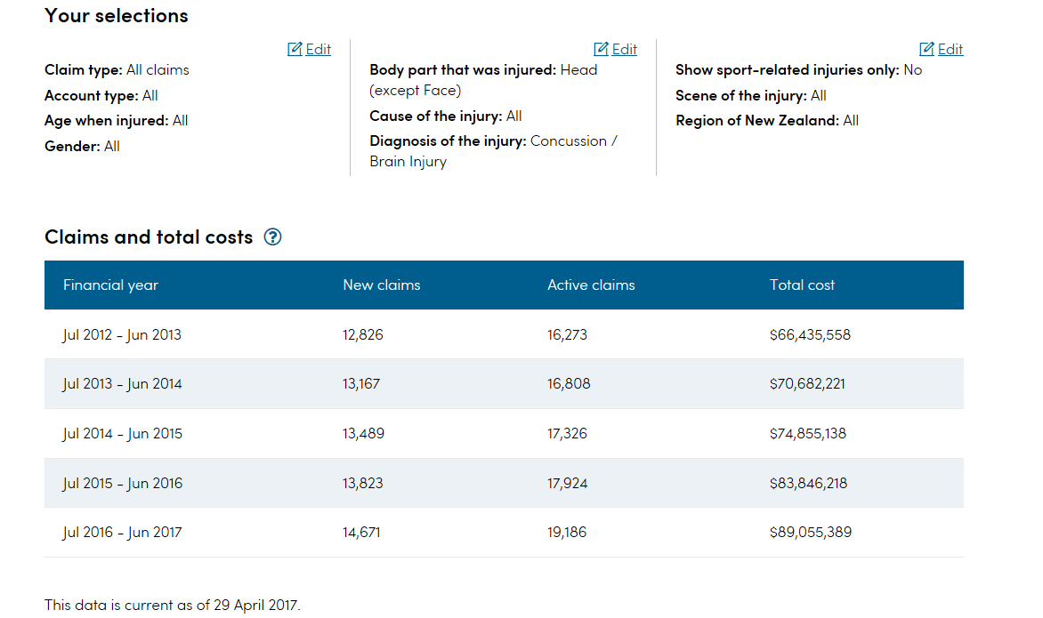
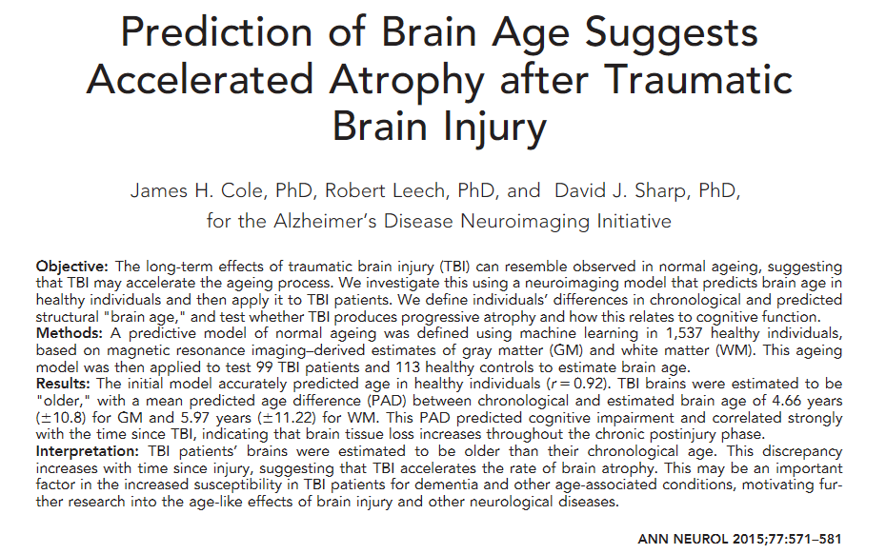

Slide 23
