Slide 1

2016 ACRM Conference

Slide 2
Cloud-based Client Management System: a novel approach enabling communication across the rehabilitation team and funders that drives the rehabilitation process
Tony Young
National Rehabilitation Director, ABI Rehabilitation, New Zealand

Slide 3
Disclosures
No financial interest to disclose

Slide 4
Learning Objectives
At the conclusion of this activity, the participant will have a greater understanding on novel approaches to using ECMS to:
Improve communication across the rehabilitation team
Drive rehabilitation processes
Improve patient and staff safety
Improve funder communication and engagement
Notes:
EHR and ECMS are now part of everyday clinical practice. This is a fast-growing area with more and more demands and expectations being placed on the systems we use. Despite significant advances in this area, when compared to some other industries, in my option, we still have a long way to go.
The purpose of this talk today is to share learnings around some key rehabilitation features that we have developed within our ECMS with the aim that aspects of this may be useful to you and be translated to systems that you may be using.
1. Effective communication is perhaps the most important component within an inpatient rehabilitation facility to maintaining safety and facilitation rehabilitation. So, the question I have is…. How can the ECMS assist with communication from, if you like, the top down to ensure all staff know how to complete a task e.g. when an OT assesses and sets a person up with a showering protocol – how can we use a ECMS to communicate this and facilitate improved consistency across all the involved staff?
AND
How can we use the ECMS to assist with bottom up communication? There is so much useful information that may go missed if there is not an easy means for ‘floor staff’ to communicate issues they are seeing or provide feedback on how easy or hard an individual may be finding the rehab task that has been set.
2. It is not enough to have a CMS that is simply a document management system. What we needed was a system that informs staff of the daily plan, prompts you to update plans, facilitates interdisciplinary work and promotes a 24/7 approach to rehabilitation.
3. Using an ECM to communicate clinical risk assessments and appropriate plans to minimise risk is pretty standard – what we want to be able to do was to enable all staff to easily communicate their concerns about safety and significant events along with the action plan be shared across all staff that may come into contact with the client
And finally
4. The funder is sometimes a forgotten partner in the rehabilitation team – their role however a vital one. The issue we were faced with was how we could share key information, particularly about discharge and continued needs, with the funder in a manner that would not breach the privacy regulations.
So, the way we will be covering these objectives is by demonstrating 3 recent functionalities that that we have implemented within the inpatient rehabilitation setting. The common theme across all 3 of these functionality is improved communication. For each I will present the problem we were faced with, which I’m sure will be similar across other services, the solution and then a short video or two to demonstrate the functionality – as it may make more sense if you see how it works.
Prior to running through the functionalities, to give some context, I will give an overview of our service and a brief look at a some of the good and the not so aspect to electronic health records and management systems.

Slide 5

Learning Objectives Take Two
Notes:
So this is a repeat of the previous slide – and is really here for a bit of fun.

Slide 6

Notes:
Although this was just a bit of fun the aim here was to demo that we can use IT to help create some engagement.

Slide 7



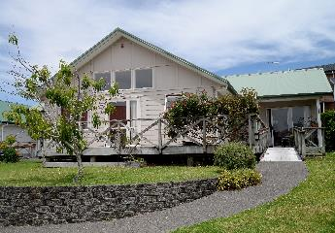
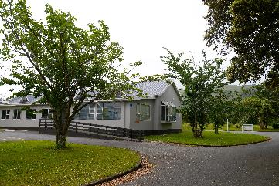
abi Rehabilitation
Sites in Auckland and Wellington
Sole provider of Brain injury Rehabilitation in
North Island
Notes:
So a brief bit about me and where I work… I am the National Rehabilitation Director of a New Zealand based private company called ABI Rehabilitation. We are the main providers for adult inpatient brain injury rehabilitation in New Zealand serving about 85% of the population. We have facilities in our largest city Auckland and in our capital city Wellington (the 2 blue dots).

Slide 8
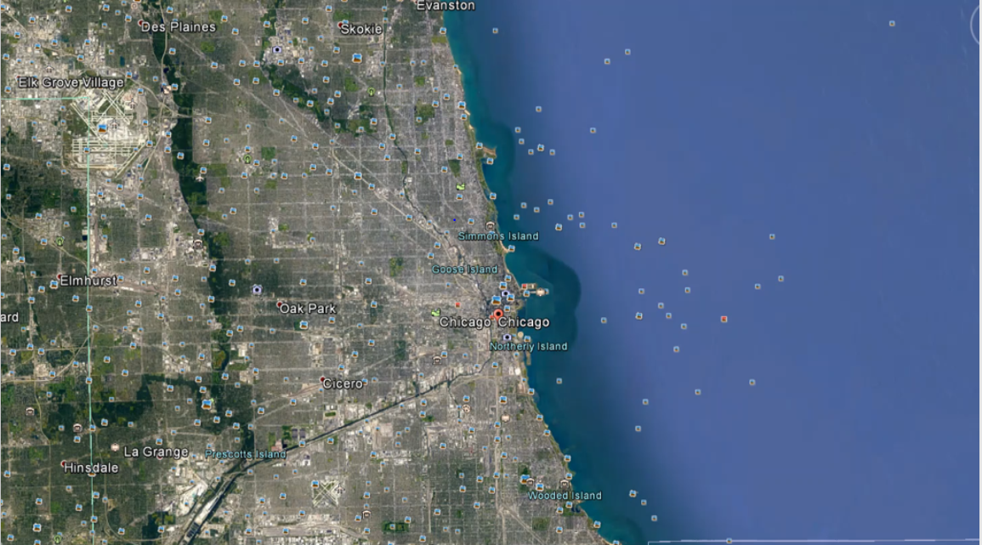
Chicago to Auckland
Notes:
So for those unfamiliar with where New Zealand is here is a quick tour from Chicago

Slide 9
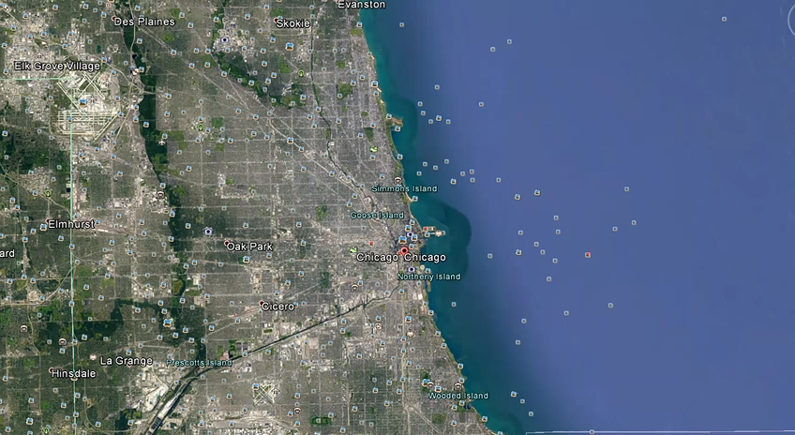
Notes:
So this is the Auckland site. It is made up of 7 houses with a total of 33 beds. Each house has a purpose e.g. behavioural unit, emerging consciousness, transitional living or high medical/nursing needs. Clients move through the houses as they progress.

Slide 10






























Landscape, Flora & Fauna…
Notes:
So here are some shots from around NZ – NZ is well known for its incredible landscape, mountains, lakes and beaches. It is also famously known for for its national sport rugby and the national team the All Blacks

Slide 11
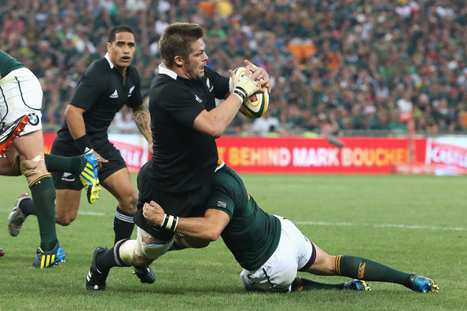
Our Rugby…
Notes:
So, as you may know this weekend is a very big weekend for rugby here in Chicago. The NZ Maori’s are playing the Eagles on Friday night and the All Blacks are playing Ireland on Saturday night. So I though it was fitting to stick with the rugby theme of the next few slide or two…

Slide 12


Notes:
This is a great story of the rise and fall of the Pontypool Welsh rugby club which has clear stolen the name form the Clint Eastwood Western. I thought this title was quite fitting when talking about ECMS. I think it is fair to say that most CMS will have plenty of good (that we tend to embellish), components of bad (that we tend to find work arounds) and unfortunately a fair bit of the ugly!

Slide 13

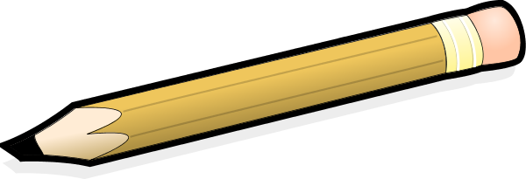
Quality, Efficiency and Communication
The
Good
Improved care coordination
A single point of entry
Availability of information
Improved data accuracy and legibility
Automatic warnings, reminders, triggers
Data Analysis
Notes:
So lets talk about the good…
ECMS have the ability to share patient records through network-connected health settings leading to improved efficiencies and care coordination.
There can be a Single point of entry, meaning that you can record something in one place and it will appear everywhere it needs to be. Systems (either paper or electronic that require information to be re written if different places creates the potential for conflicting information to be written resulting in confusion and clinical risk.
ECMS enable automated or templated documentation, generate reports and have filter and search functions making recalling information quick and easy.
My handwriting is atrocious – sometimes I would struggle to read my own clinical note. Having typed notes with spell check, warnings and reminders built in significant improves accuracy and legibility.
Systems have the ability to have parameters or dates set and when this are benched reminders or notifications can be actioned
There is also the ability with relative ease to analysis data – this may be a an individual level – reviewing to see if someone is making progress or analysing collective data to track and tend or to assist with research based questions.
As artificial and business intelligence is developed and incorporated more into these systems it is likely there will be continued benefit from the data analysis aspect

Slide 14
The
Bad
Costs and Underdelivering
Benefits not as expected
Low productivity
High cost to implement
Ongoing maintenance, development and testing
Upskilling of staff and ongoing training
Project failure
Notes:
I think it is fair to say that we have very high expectations when it comes to how technology should make our lives better. What I want from a CMS as a floor staff member will be different to what the doctor wants, or what the manager wants. Having a CMS that will meet everyone's expectations and needs is very challenging. Now throw in the fact that the contracts you work under change, the reporting requirements alter or the measurements you need to use have been updated – ECMS always seem to be trying to catch up to the changing needs and expectations
Low productivity – There was an interesting study done that reviewed the introduction of a EHR system (from a paper system) into an ED department. The expectation was that there would be an improvement to workflow and productivity – however it was found that on average it was taking each doctor 4 hours a week longer to complete their documentation. Having a sound understanding of the workflow is essential – having assisted technology that slows the processes or makes life worse will have a very short life.
Costs - There is generally significant initial set up costs and then there is the ongoing costs associated with software and hardware upgrades, maintenance of the software and staff training but perhaps the biggest financial risk is that of project failure. The largest of which was the Lorenzo patient record system in the UK which had to be discontinued – this was reported to be at a cost of over $24 billion US.

Slide 15
Privacy Breaches
The
Ugly
Internal (who accessed what information when, where and why?)
External (system hacked on purpose or client info distributed by accident)
Notes:
I have considered the risk associated with privacy breaches as the ugly.
How do you control who can see what. Can you assure the patients you serve that their information will NOT be accessed by anyone that does need to know that information?
In the 5 year period of early 2011 to late 2015 (US data only)
859 Medical and healthcare providers have experienced security breaches
Compromising almost 28 million patients files
(www.privacyrights.org/data-breach)
Despite acts such as the Privacy Act and Health Insurance Portability and Accessibility Act (HIPAA) there is no realistic way to estimate the number of people who may come across your records.
What is an acceptable risk to enable shared medical records?

Slide 16
Ease of information
Privacy
Notes:
On one hand you have the need for information and with being able to get it with ease there are likely to be improvements to efficiencies, potentially improved patient treatment and therefore outcomes. However on the other hand is that of privacy.
The question we need to continue to challenge ourselves with is: Is this information only being shared with those that need to access the information?

Slide 17
3 Key Features to be Discussed
Driving the rehabilitation process
Communication and management of actual risks and concerns
Secure information sharing with funder
1. Driving the rehab process
2. Communicating risks & concerns
3. Funder communication
Notes:
Right – As promised earlier – here are the 3 recent enhancements we have made to our CMS. I will highly the issues we had, the solution we came up with and then demo how it works in reality. Again the aim of this is to share learnings and offer ideas that may be possible to work within systems you have.

Slide 18

1. Driving the Rehabilitation Process
ISSUES
How to
Ensure consistence of care and rehab?
Develop meaningful plans in a timely manner?
Easily update and inform everyone of the changes?
Easily obtain information when you need it?
Enable feedback on how the rehab is going?
1. Driving the rehab process
2. Communicating risks & concerns
3. Funder communication
Notes:
During the course of a week or even a day our clients are subjected to numerous staff. A key challenge for us was to improve the consistency, frequency, and engagement (from both clients and staff)

Slide 19
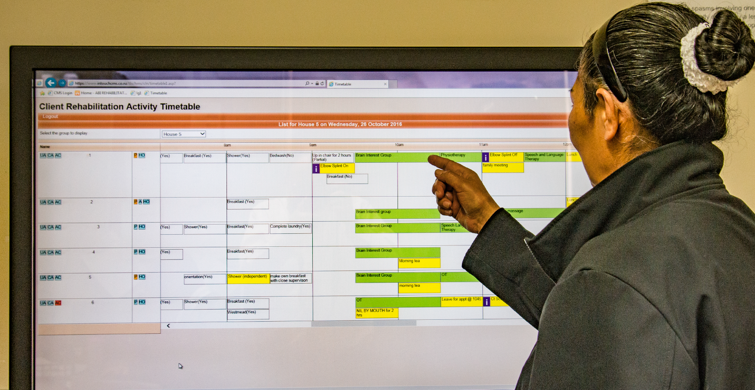
1. Driving the rehab process
2. Communicating risks & concerns
3. Funder communication

Slide 20

Driving the Rehabilitation Process
SOLUTION
Templating rehab and care plans
Integrating plans to the daily timetable
E-mail alerts sent on review date
Notification of updates flagged on the timetable
Staff to report level of engagement and difficulty of rehab and care plans
Review data at individual and collective levels
1. Driving the rehab process
2. Communicating risks & concerns
3. Funder communication
Notes:
And here comes the story how we did this…

Slide 21
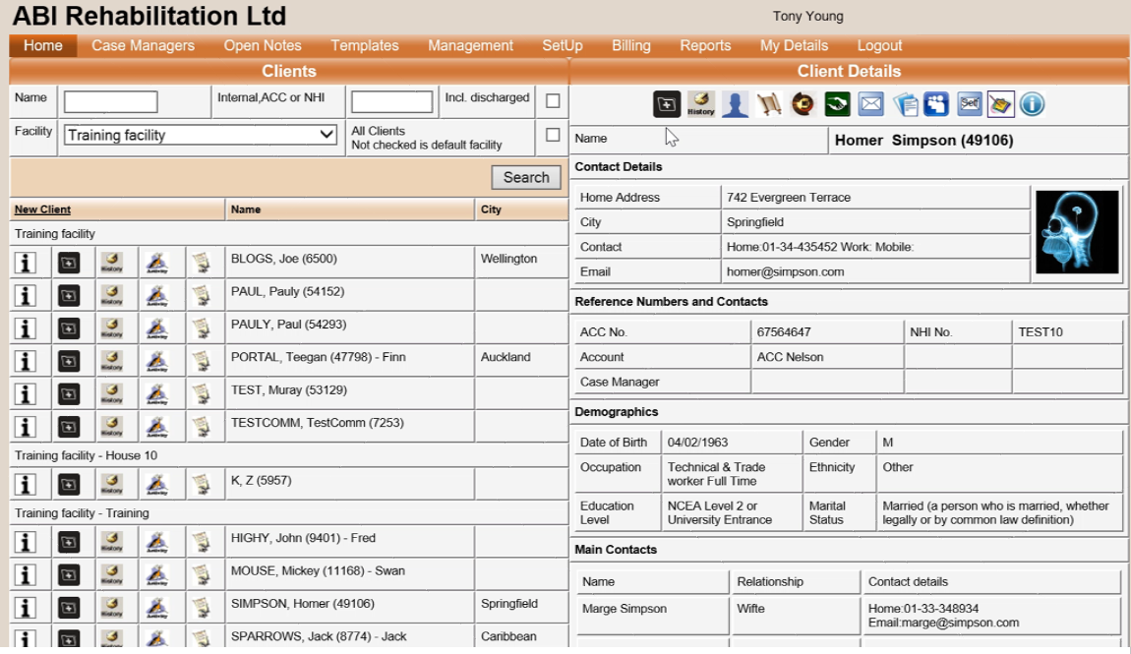
Building a Rehabilitation Activity
1. Driving the rehab process
2. Communicating risks & concerns
3. Funder communication

Slide 22
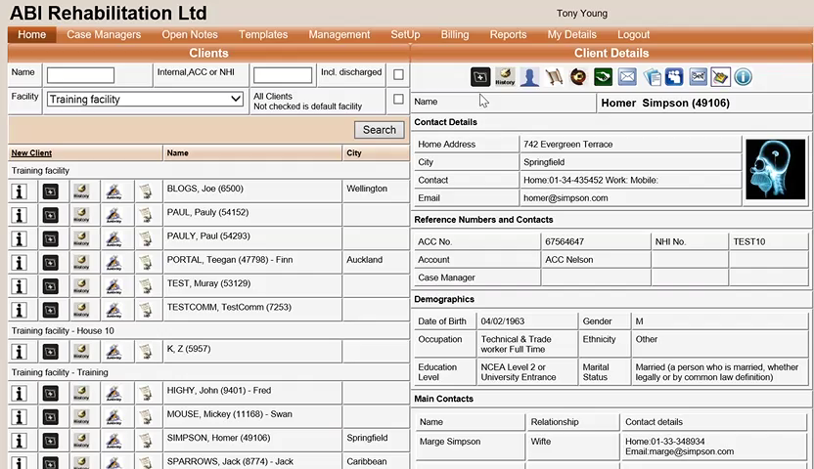

Slide 23
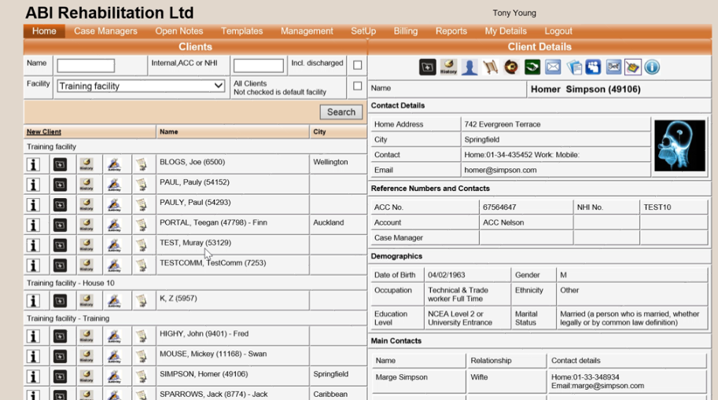
Adding Activities to Timetables
1. Driving the rehab process
2. Communicating risks & concerns
3. Funder communication

Slide 24
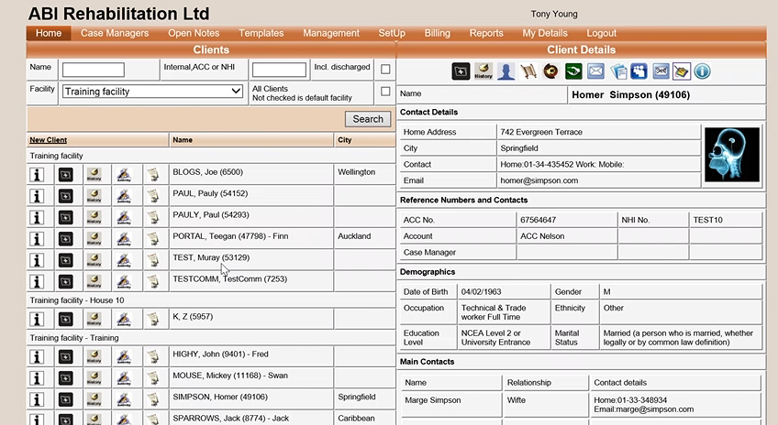

Slide 25
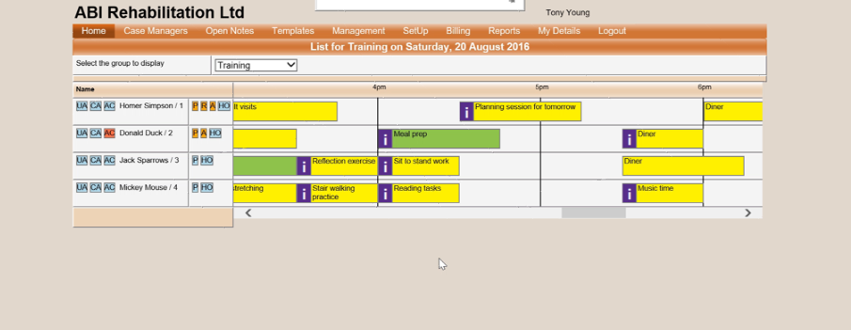
Closing Activities and Recording Engagement
1. Driving the rehab process
2. Communicating risks & concerns
3. Funder communication

Slide 26
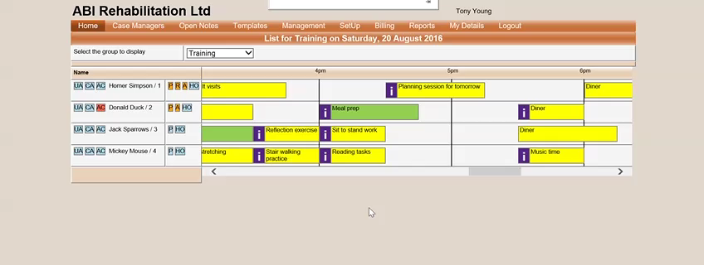

Slide 27
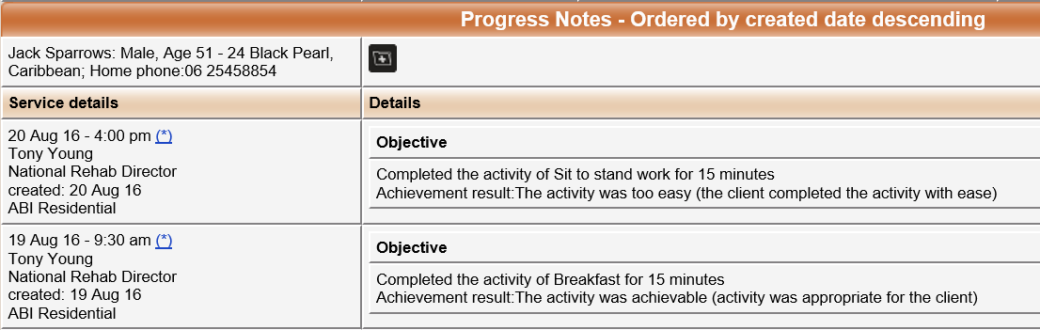
Entry to Notes
1. Driving the rehab process
2. Communicating risks & concerns
3. Funder communication

Slide 28
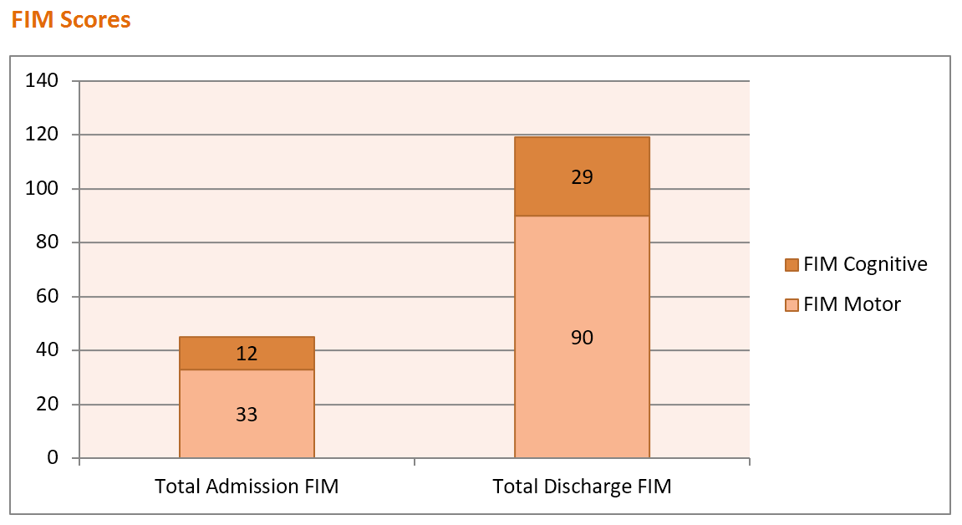
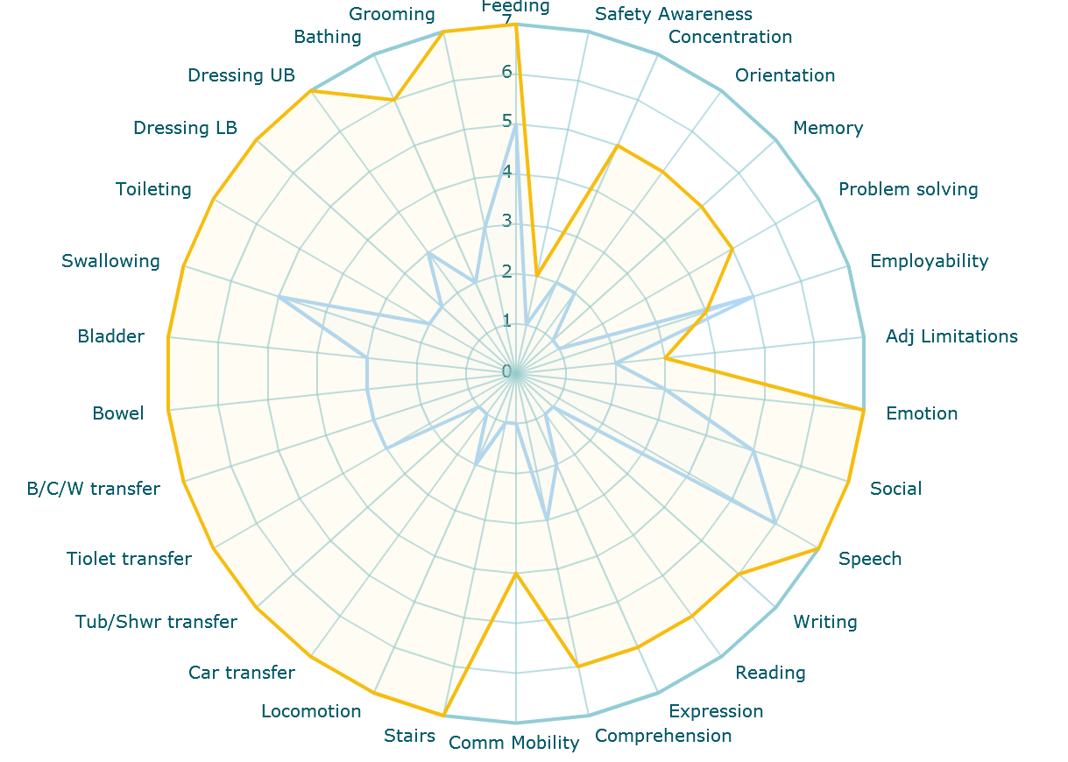

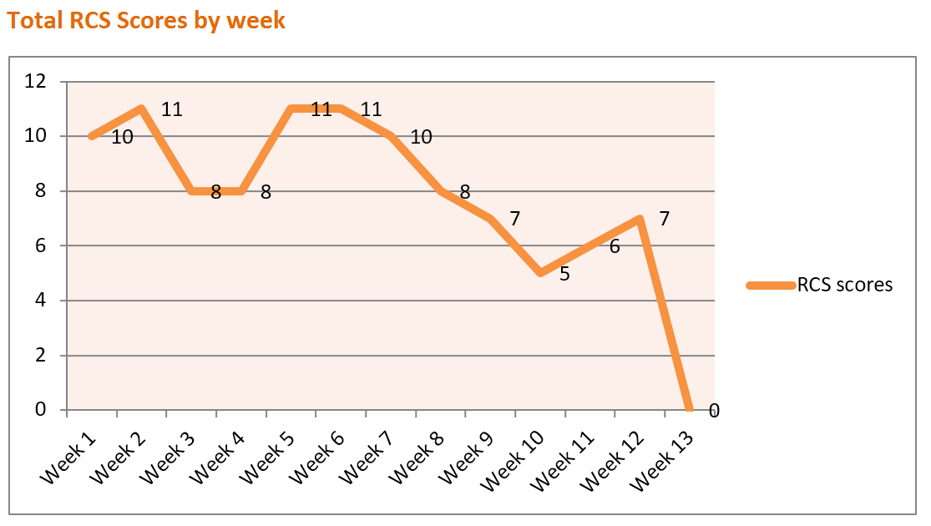
Activity Summary
Week of 16/08
completed rehab activities: 90% | Reasons not completed: 2% hospital appointment 8 % fatigue issues
Client
Dashboard
Risk assessment completed | Yes
Unmanaged high risks | 1
% protocols expired | 5
1. Driving the rehab process
2. Communicating risks & concerns
3. Funder communication

Slide 29
Rehab Complexity Scale (RCS)
Developed by Professor Lynne Turner-Stokes
RCS is a reliable, validated tool that is responsive to change and captures a number of medical and therapy inputs that the FIM and Barthel Index do not (Turner-Stokes, Williams, & Siegert, 2010)
15-point scale with five components
  Care and support needs
  Skilled nursing needs
  Therapy disciplines
  Intensity of inputs and
  Medical intervention
  A client’s complexity can be categorized based on their total RCS score
  (Turner-Stokes, Disler, & Williams, 2007)
1. Driving the rehab process
2. Communicating risks & concerns
3. Funder communication
Notes:
Developed by Professor Lynne Turner-Stokes and her colleagues at King’s College London School of Medicine and the Northwick Park Regional Rehabilitation Unit

Slide 30
RCS components and scoring
Each of the 5 Components
Level 0
Level 1
Level 2
Level 3
1. Driving the rehab process
2. Communicating risks & concerns
3. Funder communication

Slide 31
Total RCS scoring
Complexity Band | Total RCS weekly score
Very Low | 0-3
Low | 4-6
Medium | 7-9
High | 10-12
Very High | 13-15
1. Driving the rehab process
2. Communicating risks & concerns
3. Funder communication

Slide 32
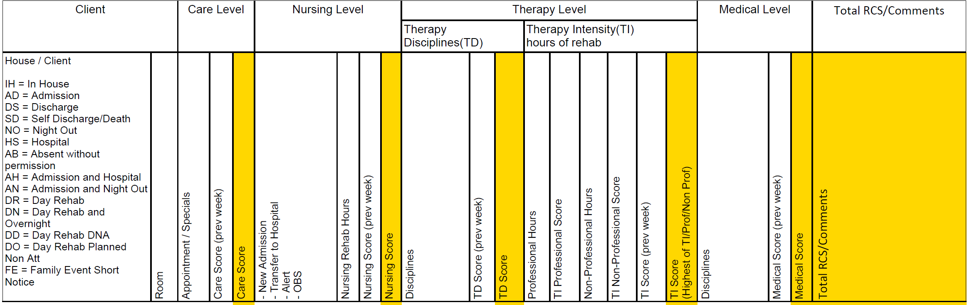
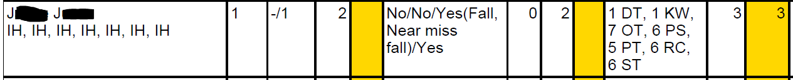
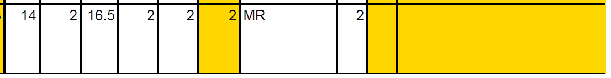
Data to guide RCS scoring
1. Driving the rehab process
2. Communicating risks & concerns
3. Funder communication

Slide 33
Reflecting on intensity
1. Driving the rehab process
2. Communicating risks & concerns
3. Funder communication

Slide 34
Automating initial reports
Value of an initial report?
Key measures we needed on admission
  Nursing assessment
    Process checks surrounding safety
  FIM
  Overt Behavior Scale (OBS)
  Rehabilitation Plan
  Discharge planning form
1. Driving the rehab process
2. Communicating risks & concerns
3. Funder communication

Slide 35
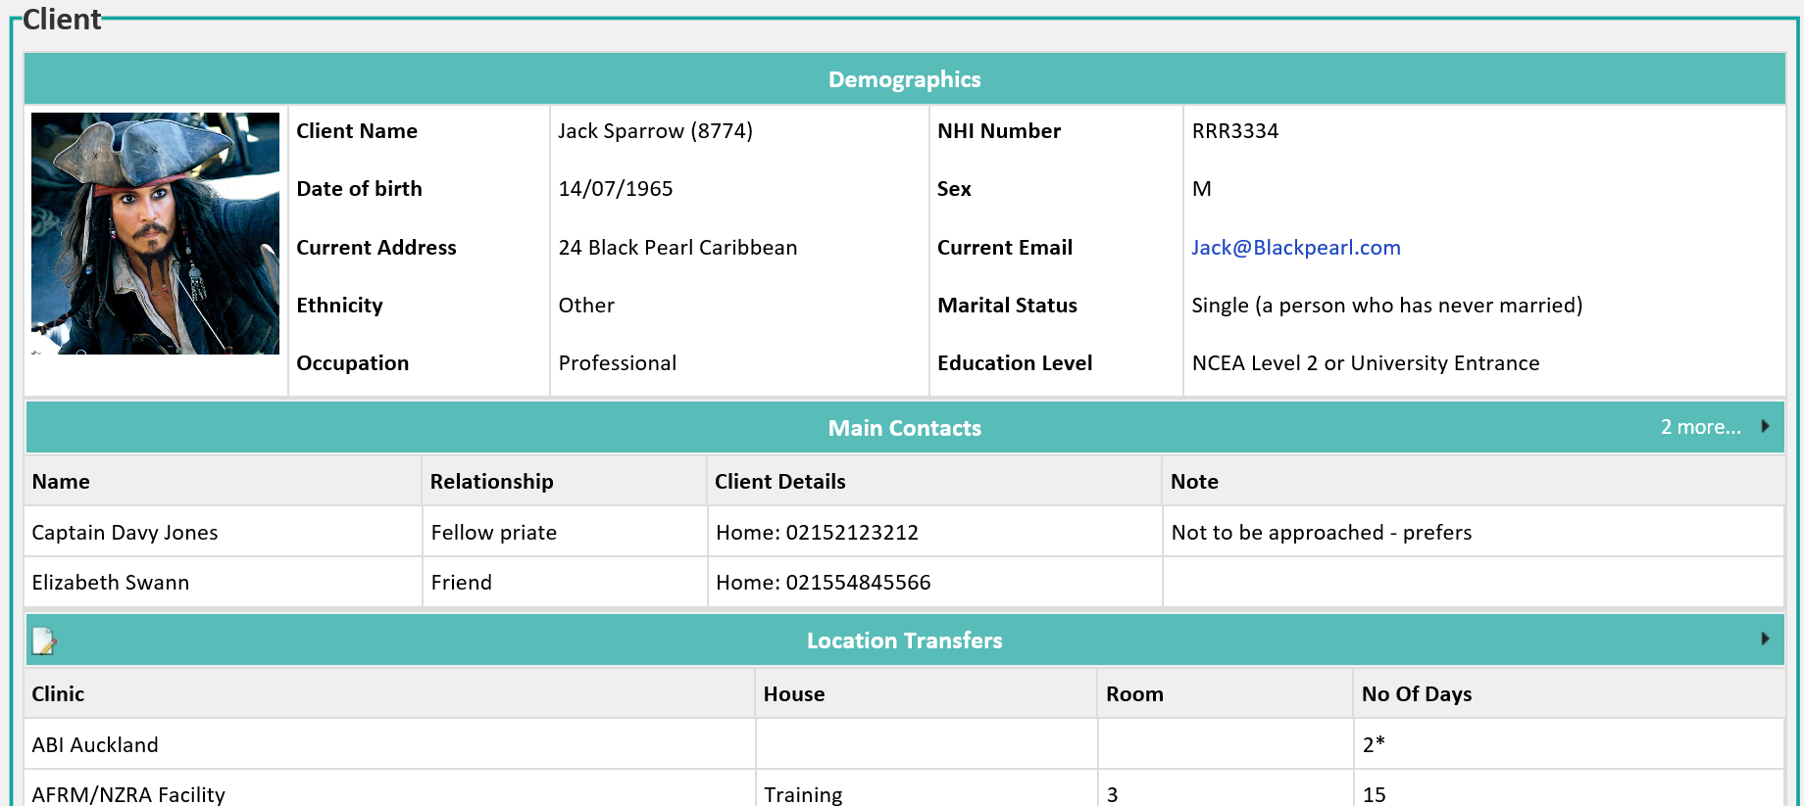
Automating initial reports
1. Driving the rehab process
2. Communicating risks & concerns
3. Funder communication

Slide 36
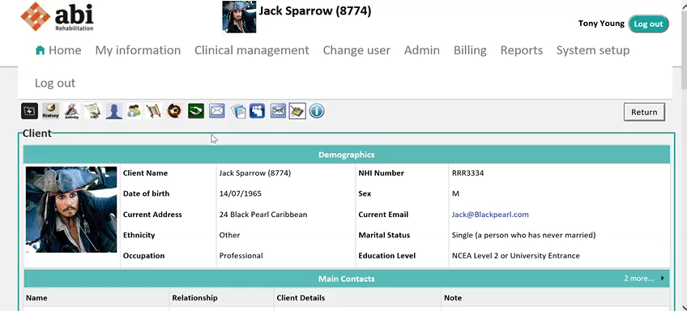

Slide 37
Benefit of these Developments
Time Saving
  In writing rehab plans and documentation/reports
Safety
  Easy access to most up to date information
Consistency
  On how the information to displayed and how it is delivered
Rehabilitation focus 24/7
  Greater intensity resulting in shorter length of stays
Feedback provided
  Decision making being assessed by data
  Capturing of key outcomes on admission
1. Driving the rehab process
2. Communicating risks & concerns
3. Funder communication

Slide 38
2. Communication and Management of Actual Risks and Concerns
ISSUE
1. Driving the rehab process
2. Communicating risks & concerns
3. Funder communication

Slide 39
Communication Failures
N = 2455
Leonard, Graham & Bonacum 2004
1. Driving the rehab process
2. Communicating risks & concerns
3. Funder communication
Notes:
The Joint Commission for Hospital Accreditation investigated about 2.5 thousand reported sentinel events. They determined that for over 70% the primary root cause was communication failure.
It goes without saying that effective communication and teamwork is essential for the delivery of high quality, safe patient care.
All to frequently, effective communication is situation or personality dependent. Research from other high reliability domains such as commercial aviation have shown that the adoption of standardised tools is very effective in enhancing teamwork and reducing risk.
Equally important is creating an environment that feels ‘safe’ for team members si they can speak up when they have safety concerns about a patient or situation.

Slide 40
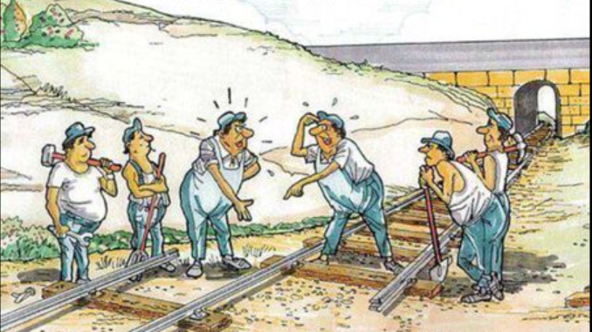
Communication and Teamwork
1. Driving the rehab process
2. Communicating risks & concerns
3. Funder communication
Notes:
So here we have a situation!
Of course this is just a cartoon and would never happen in real life!

Slide 41
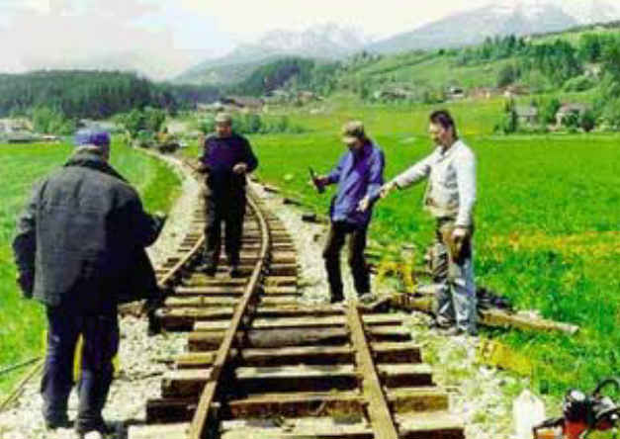

Slide 42
2. Communication and Management of Actual Risks and Concerns
ISSUE
How do floor staff notify others of their concerns?
How do others find out about client alerts?
How can we speed up the process of investigation?
1. Driving the rehab process
2. Communicating risks & concerns
3. Funder communication
Notes:
Talk through the 2 examples
Client becoming unwell over the week and resulted in a fall in the bathroom – review of notes…
Client physically acting out – debrief held not knowing of another event 5 minutes ago

Slide 43
Incident reporting and investigation 2014
1. Driving the rehab process
2. Communicating risks & concerns
3. Funder communication

Slide 44
Communication and Management of Actual Risks and Concerns
SOLUTION
Enable an easy means to communicate alerts and concerns
Notify key staff in real time
Notify all staff via the timetable screen of an alert
Enable clinical leaders a means to communicate the plan
Tracking and trending of Alerts and Concerns
1. Driving the rehab process
2. Communicating risks & concerns
3. Funder communication
Notes:
And here comes the story how we did this…

Slide 45
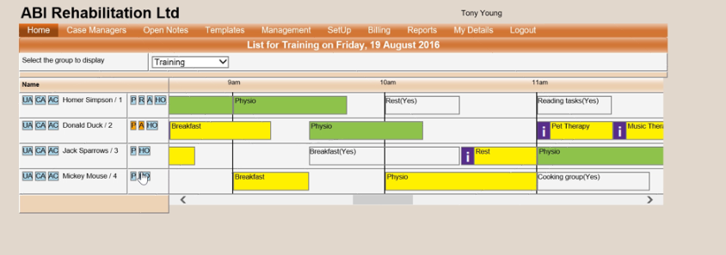
Adding Alerts and Concerns
1. Driving the rehab process
2. Communicating risks & concerns
3. Funder communication

Slide 46
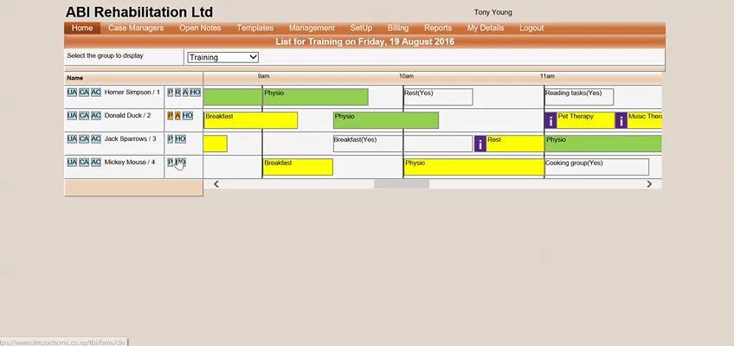

Slide 47
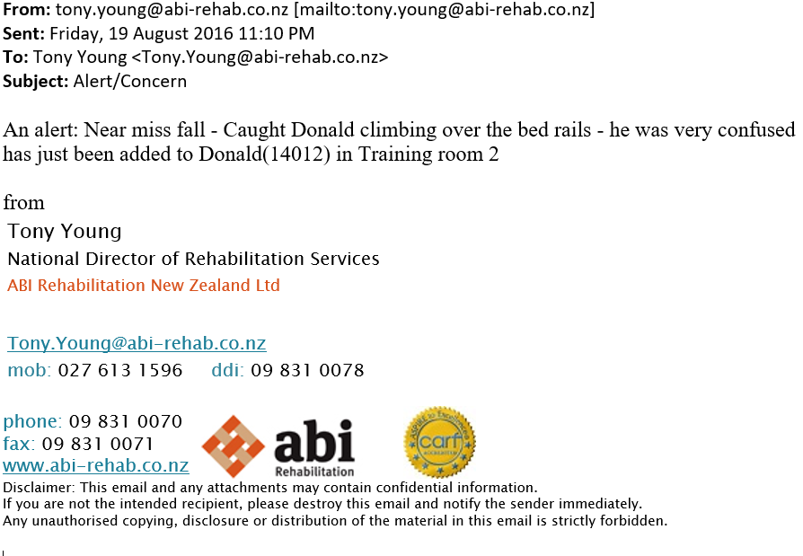
E-mail Notification
1. Driving the rehab process
2. Communicating risks & concerns
3. Funder communication

Slide 48
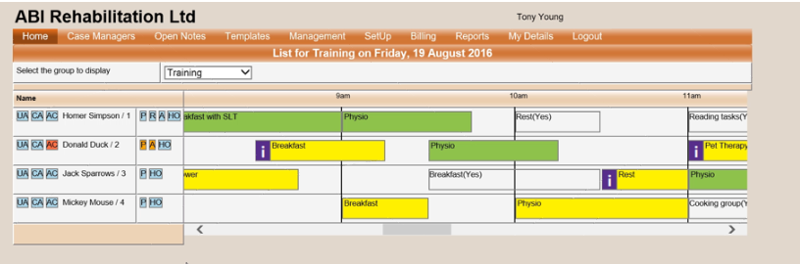
Viewing Comments to Alerts
1. Driving the rehab process
2. Communicating risks & concerns
3. Funder communication

Slide 49
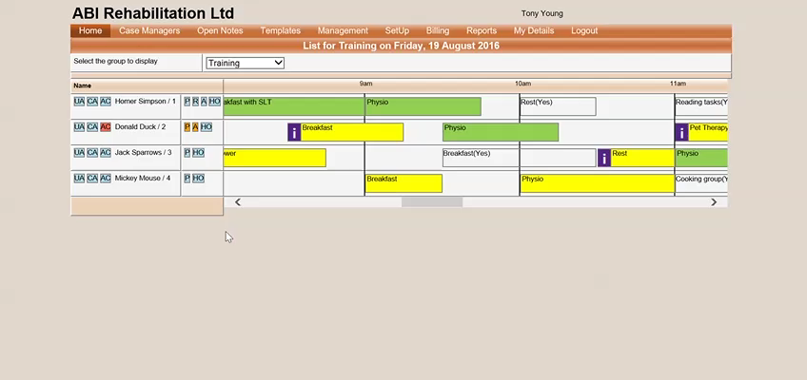

Slide 50
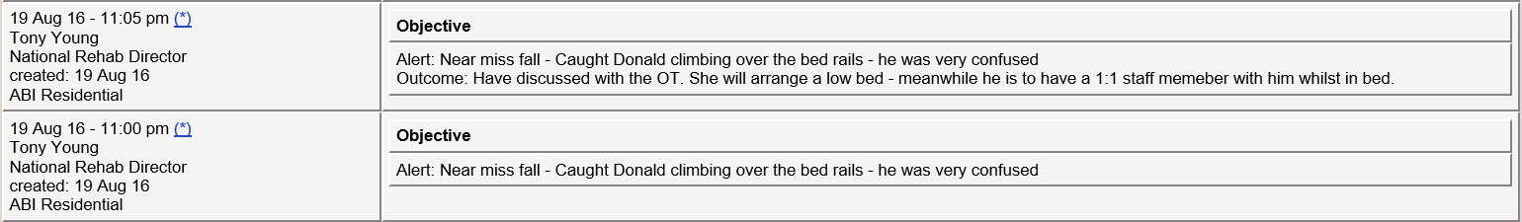
Entries to Notes
1. Driving the rehab process
2. Communicating risks & concerns
3. Funder communication

Slide 51
3. Secure Information Sharing with Funder
ISSUE
How to
Improve communication?
Share information in a secure manner?
1. Driving the rehab process
2. Communicating risks & concerns
3. Funder communication
Notes:
And here comes the story how we did this…

Slide 52



How can we share this?
ACC
ABI
1. Driving the rehab process
2. Communicating risks & concerns
3. Funder communication

Slide 53
Why not just use E-Mail?
New Zealand Ministry of Health
Health Information Privacy Code 1994:
“Email poses special problems in privacy. Use of email to transmit health information
may result in the information being stored on several hard drives, not all of which may
be secure from unauthorised access. There is also a risk of interception during the
transmission, as email commonly passes through a number of computers on the way
to its final destination.”
“…normal email is stored in an unencrypted format on the Internet Service Provider’s server and
is therefore readable by third parties;”
“Do not send patient identifiable information or attachments over unsecured email.”
Health Information Security Framework 2009
New Edition December 2008
1. Driving the rehab process
2. Communicating risks & concerns
3. Funder communication
Notes:
Standards within NZ from both MoH and Health information privacy code highlight the potential risk involved with sharing health information via the use of email. Both these guides do not ban the use of email. However, they strongly suggest that internal policies are developed with the awareness of the potential risk to reduce or eliminate privacy breaches. Such recommendations include: encrypting email, discouraging lengthy chain responses, and establishing guidelines on what information is acceptable to be emailed

Slide 54
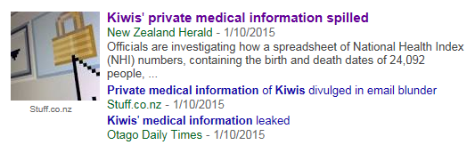
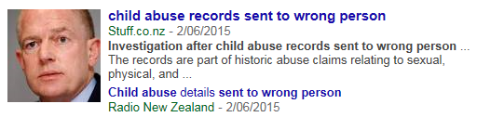

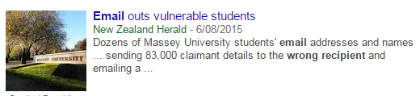
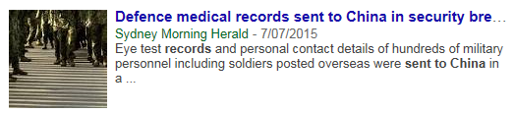
Why not just use E-Mail?
1. Driving the rehab process
2. Communicating risks & concerns
3. Funder communication
Notes:
Here is a handful of breaches of privacy via e-mail
One of the problems with e-mail functions is that it is too good! It is easy to attach a file and with the auto populate addresses the process of sending information is very fast – however the risks are there. How do we check to ensure the attachment is the correct one and I’m sure we have all been guilty of sending an email to the wrong person.

Slide 55
The Funder Portal
SOLUTION
Develop a Funder portal
Enable templated email notifications
Ensure mutual benefit
1. Driving the rehab process
2. Communicating risks & concerns
3. Funder communication
Notes:
And here comes the story how we did this…

Slide 56
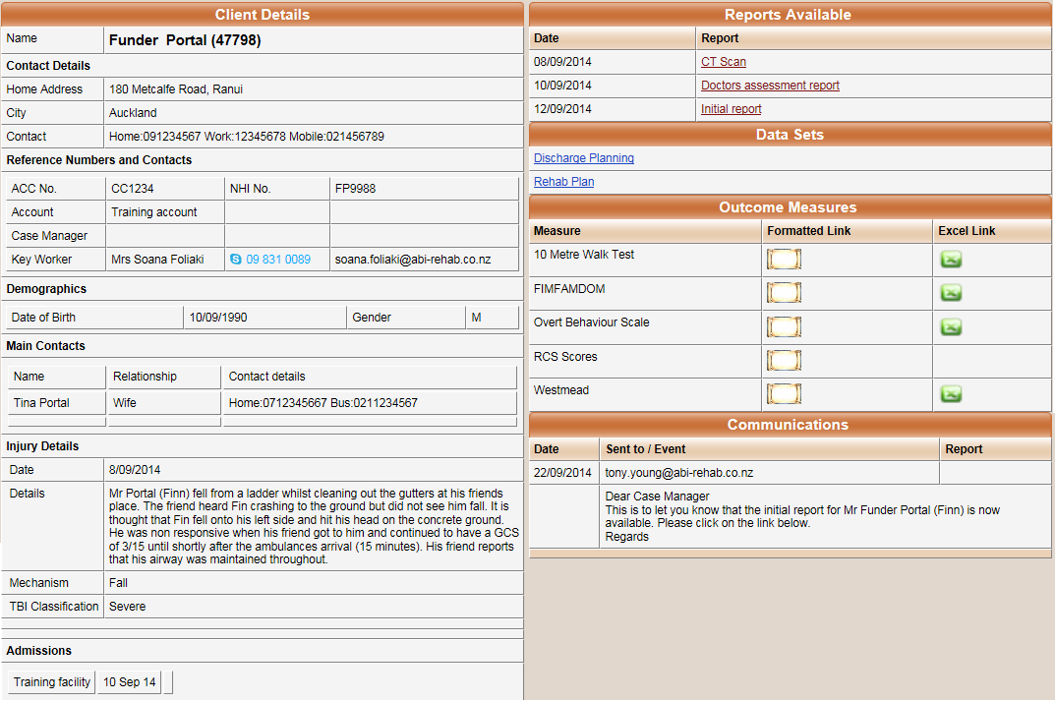
What is the Funder Portal?
1. Driving the rehab process
2. Communicating risks & concerns
3. Funder communication

Slide 57
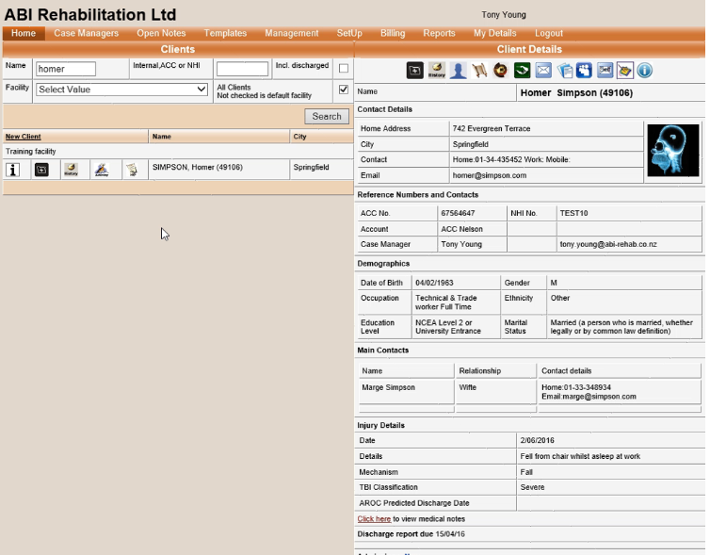
Sharing Information with Funder
1. Driving the rehab process
2. Communicating risks & concerns
3. Funder communication

Slide 58
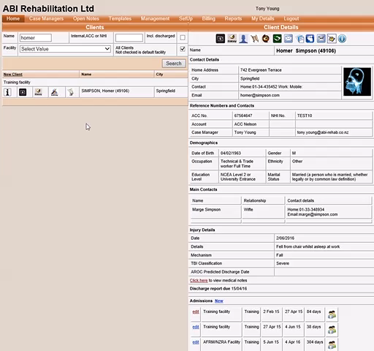

Slide 59
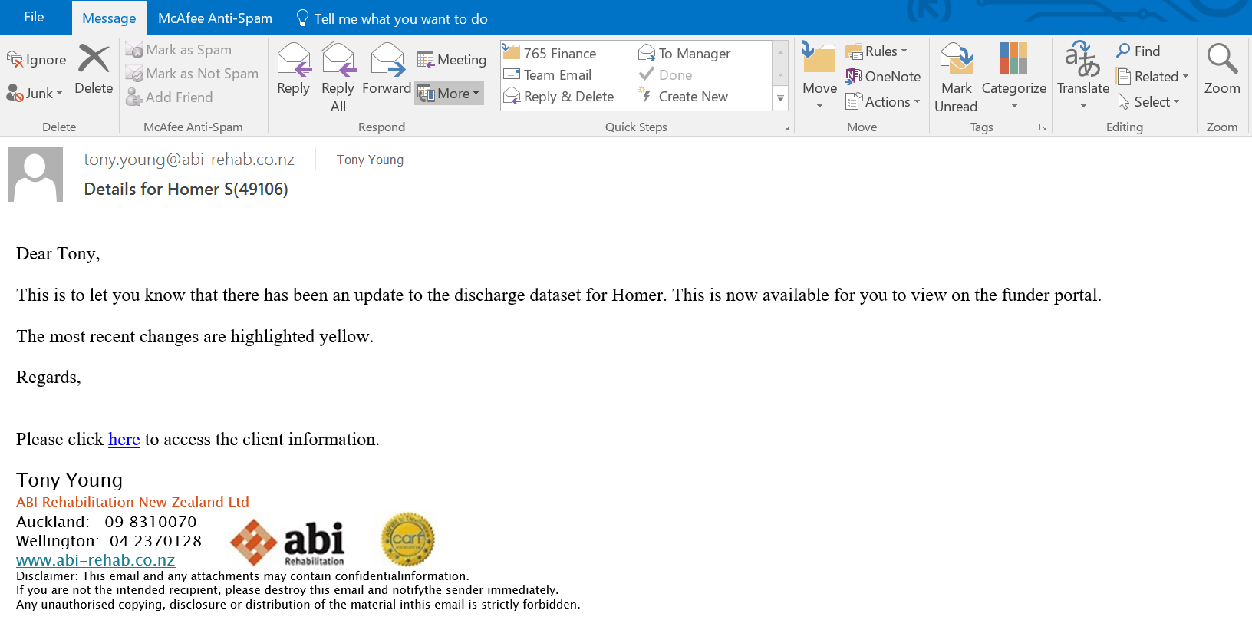
What the Funder Sees
1. Driving the rehab process
2. Communicating risks & concerns
3. Funder communication

Slide 60
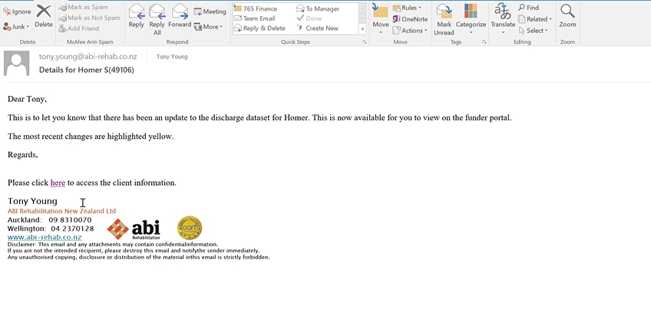

Slide 61
Key Benefits of the Funder Portal
Secure means of sharing information
  Improved privacy of Client information
  Reducing client information being sent via email
  Reducing the risk of client information being sent to the wrong person
  Access links relate to only one client
  Only accessible via ACC IP address
Quick access to information
  Access to outcome measures as they are updated
  Ability to view, download and print reports
  Ability to forward access within ACC (e.g. manager, new case manager)
  View changes to discharge planning as they are updated
  All information in one place
1. Driving the rehab process
2. Communicating risks & concerns
3. Funder communication

Slide 62
Feedback from Funder
Answer Options:
Very good
Good
Bad
Very bad
1. Driving the rehab process
2. Communicating risks & concerns
3. Funder communication

Slide 63
Summary
ABI Rehabilitation – Where we are and what we do
Pros and cons of Health Information Systems
Shared 3 functionalities that have resulted in a positive outcomes for:
  Improve communication across the rehabilitation team
  Drive rehabilitation processes
  Improve patient and staff safety
  Improve funder communication and engagement

Slide 64
Obtaining CME/CE Credit
Credit is only given to attendees who:
Successfully complete the entire course/session.
Evaluate the course – by clicking on the link in an email sent to them.
After you have completed the evaluation, an email will automatically be generated to you with a link to print your certificate.
The evaluation system will close 30 days after the date of the workshop.

Slide 65
Resources
Beaulieu, C., Dijkers, M., Barrett, R., Horn, S., Giuffrida, C., Timpson, M., et al. (2015). Occupational, physical, and speech therapy treatment activities during inpatient rehabilitation for traumatic brain injury. Archives of Physical Medicine and Rehabilitation , 222-234.
Bokhour, B. (2006). Communication in interdisciplinary team meetings: What are we talking about? Journal of Interprofessional Care , 20 (4), 349 – 363.
Chen, P., McKenna, C., Kutlik, A., & Frisina, P. (2013). Interdisciplinary communication in inpatient rehabilitation facility: evidence of under-documentation of spatial neglect after stroke. Disability & Rehabilitation , 1033-1038.
Demiris, G., Washington, K., Oliver, D., & Wittenberg-Lyles, E. (2008). A study of information flow in hospice interdisciplinary team meetings. Journal of Interprofessional Care , 22 (6), 621-629.
Eng, X., Brauer, S., Kuys, S., Lord, M., & Hayward, K. (2014). Factors affecting the ability of the stroke survivor to drive their own recovery outside of therapy during inpatient stroke rehabilitation. Stroke Research and Treatment , 1-8.
Gozalo, P., Resnik, L., & Silver, B. (2016). Benchmarking outpatient rehabilitation clinics using functional status outcomes. Health Services Research , 768-789.

Slide 66
Resources
Janssen, H., Ada, L., Bernhardt, J., McElduff, P., Pollack, M., Nilsson, M., et al. (2014). An enriched environment increases activity in stroke patients undergoing rehabilitation in a mixed rehabilitation unit: a pilot non-randomized controlled trial. Disability and Rehabilitation , 255–262.
Leonard, M., Graham, S., Bonacum, D. (2003) The human factor: the critical importanct of effective teamwork and communication in providing safe care. Quality and Safety in Health Care.
Stavrou, V., Zyga, S., Voulgaris, S., Sgantzos, M., Tsitsis, N., & Sapountzi-Krepia, D. (2014). Informal Care in a Formal Setting: the Case of a Neurosurgery Clinic in Western Greece. International Journal of Caring Sciences , 7 (1), 102-110.
Turner-Stokes, L., Vanderstay, R., Stevermuer, T., Simmonds, F., Khan, F., & Eagar, K. (2015). Comparison of Rehabilitation Outcomes for Long Term Neurological Conditions: A Cohort Analysis of the Australian Rehabilitation Outcomes Centre Dataset for Adults of Working Age. PLOS one , 1-18.
Walker, M., Sunnerhagen, K., & Fisher, R. (2013). Evidence-Based Community Stroke Rehabilitation. Dallas: Stoke - American Heart Association.
Weller, J., Boyd, M., & Cumin, D. (2014). Teams, tribes and patient safety: overcoming barriers to effective teamwork in healthcare. Postgrad medical journal , 149-154.
www.privacyrights.org/data-breach

Slide 67
2016 ACRM Conference

